Slide 1

CA1 Presentation
Loh Yip Khai
P2317454

Slide 2
PART A: CONVOLUTIONAL NEURAL NETWORK
Background research and exploratory data analysis
Feature engineering or data augmentation
Modelling and evaluation
Model improvement

Slide 3
Background research and exploratory data analysis
-Check for the number of images in each of the Test, Validation and Train folders folders

Slide 4
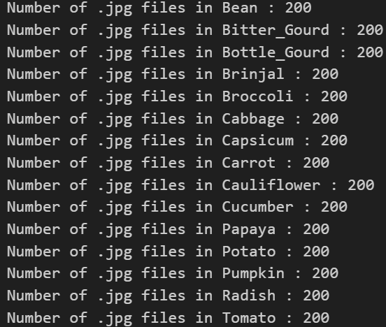
Test folder
Test(Folder) - All vegetable folder contains 200 .jpg vegetable images respectively, all images are consistent with the name of the vegetable

Slide 5
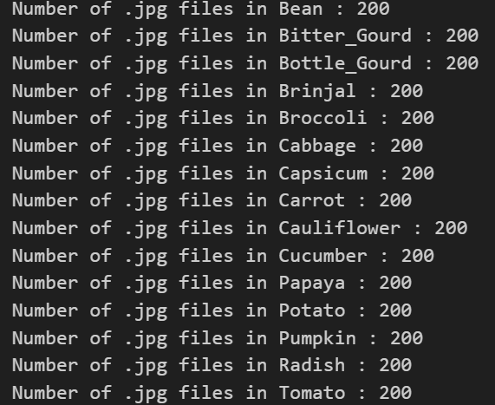
Validation Folder
Validation(Folder)- Same as Test Folder(200 images), Upon visual inspection all the images are correctly organised in their respective folders.

Slide 6
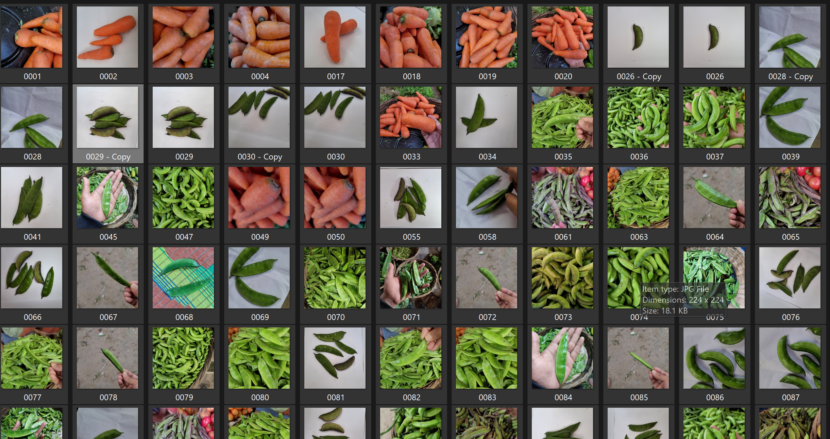
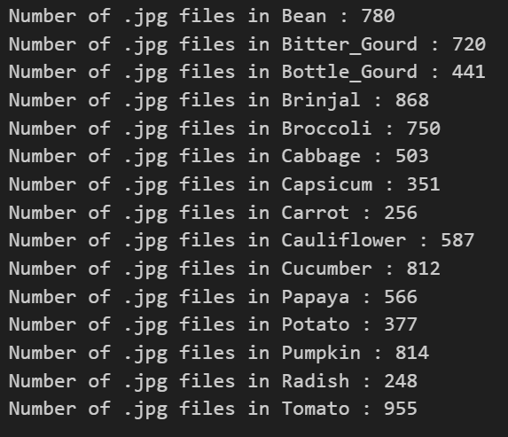
Train Folder
Unbalanced number of vegetable images, some of the folders more than the others, moreover,
-"Bean" folder contained some carrot images and copies which are unwanted. and needs to be removed

Slide 7
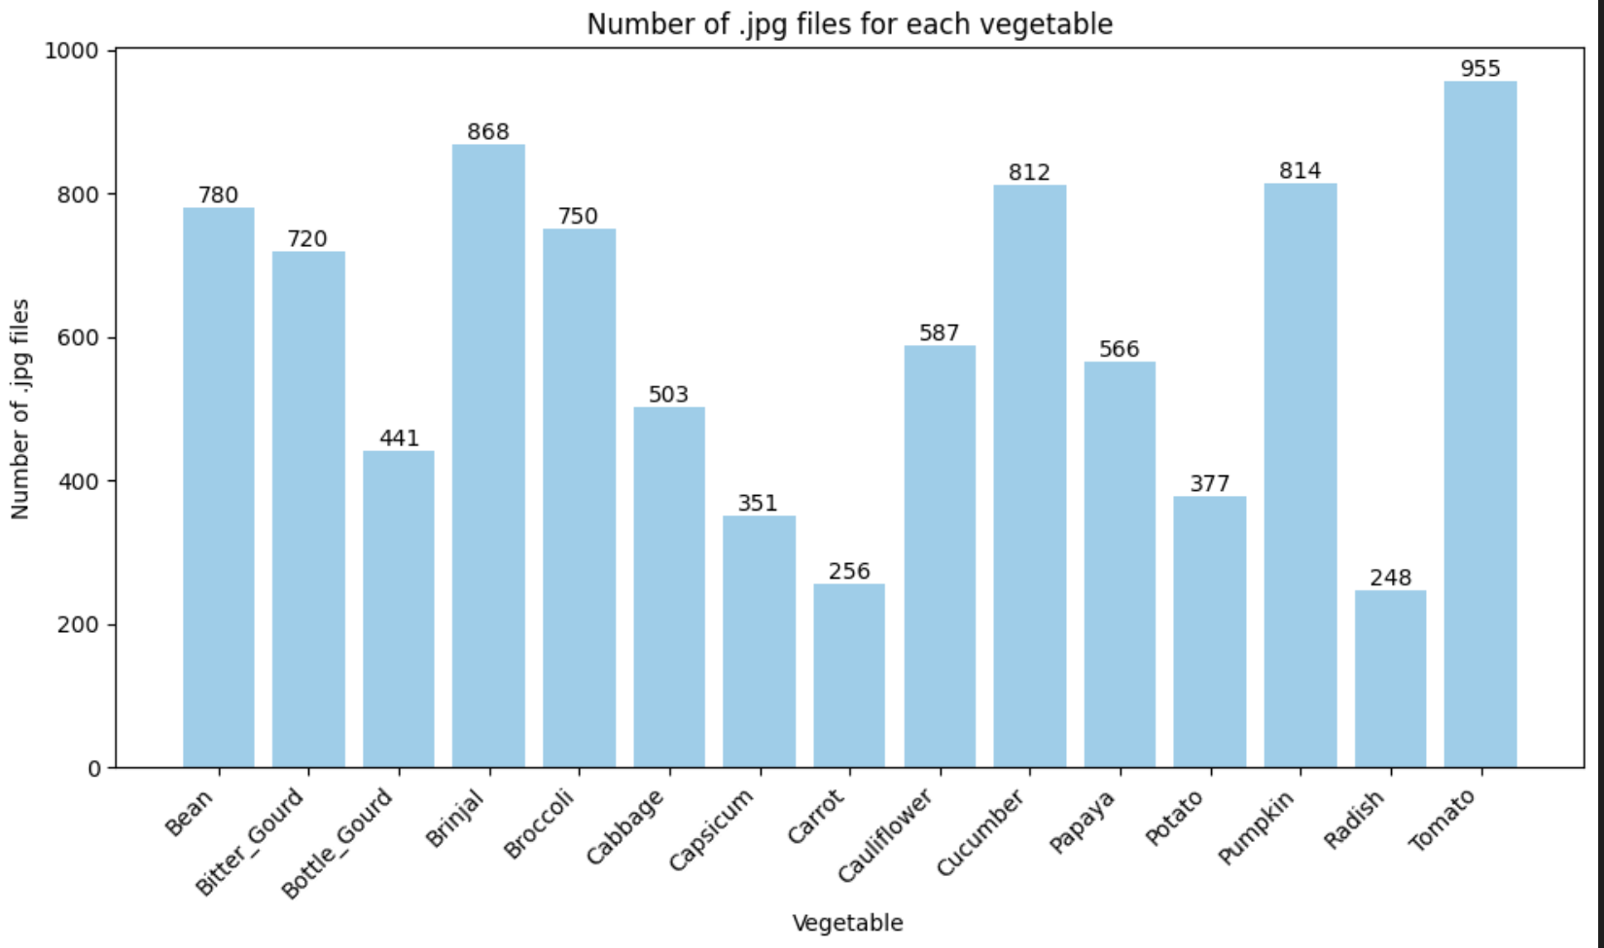
Spread of Vegetable Data(Train data)
Notes:
From here, i can see that the Max(Tomato) which has 955 images and Min(Radish) which has 248 images
There is a very unbalanced spread of data across the vegetables.
The number of images for each vegetable will definitely affect the training and testing of the model, given the unbalanced spread of data..

Slide 8
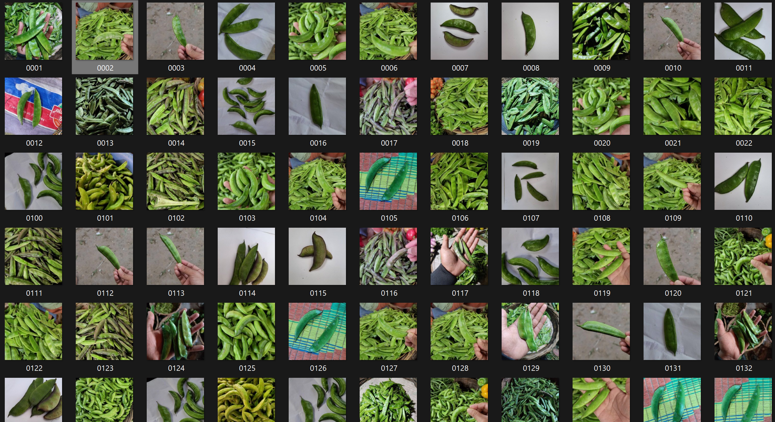
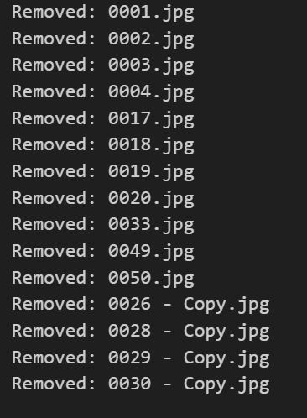
Train Folder(Continued)
Removing Carrot Images in "Bean" folder and removing bean images(copy)

Slide 9
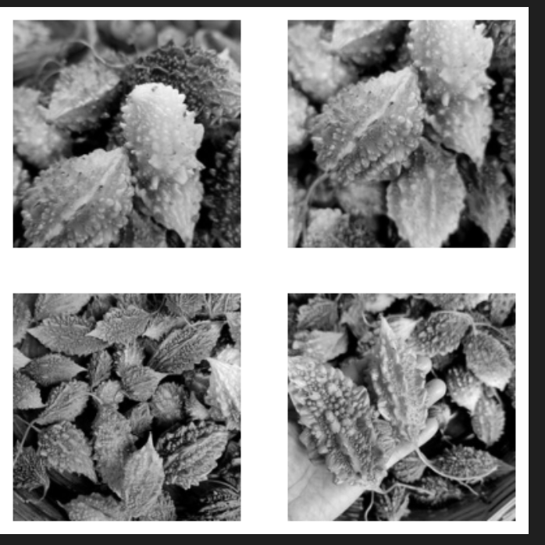
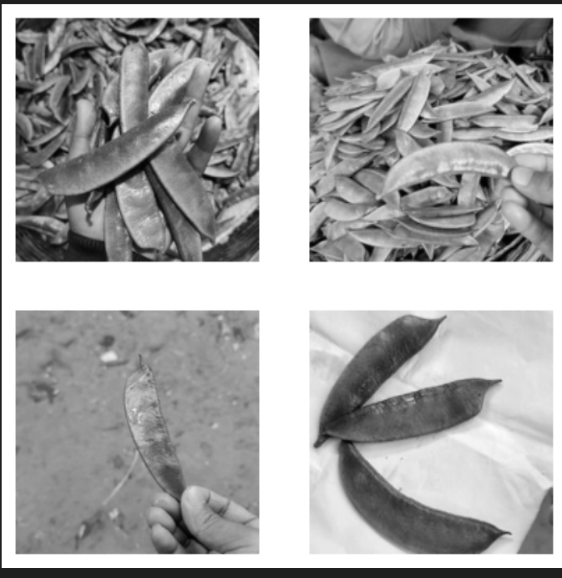
Visualising some images
- Looking at some samples of Beans and Brinjal, I observe that some of the images contained a person's hand while some do not, this may cause inaccuracies while training the model and evaluating the image.
- Also, some of the images contained multiple of the vegetable(brinjal) while some of the image contained only 1 of that vegetable(bean)
Notes:
Both of these reasons may cause a Data Imbalance,
The imbalance between single-vegetable and multi-vegetable images can skew the class distribution in your dataset. If there are significantly more single-vegetable images than multi-vegetable ones (or vice versa), the model may be biased towards the dominant class, potentially leading to suboptimal performance.

Slide 10
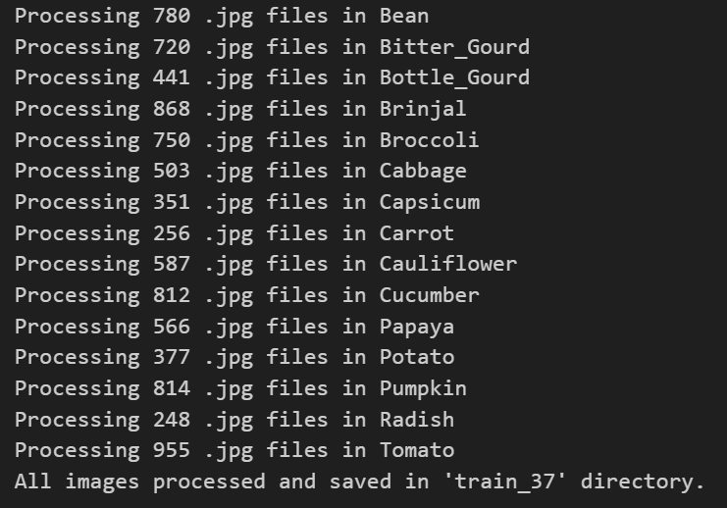
Converting images to grayscale and 37x37/131x131
I converted the vegetables images in their respective folders to grayscale and 37x 37 as required
I also did the same for Test and Validation folder and saved to Test_37 and Validation_37 respectively

Slide 11
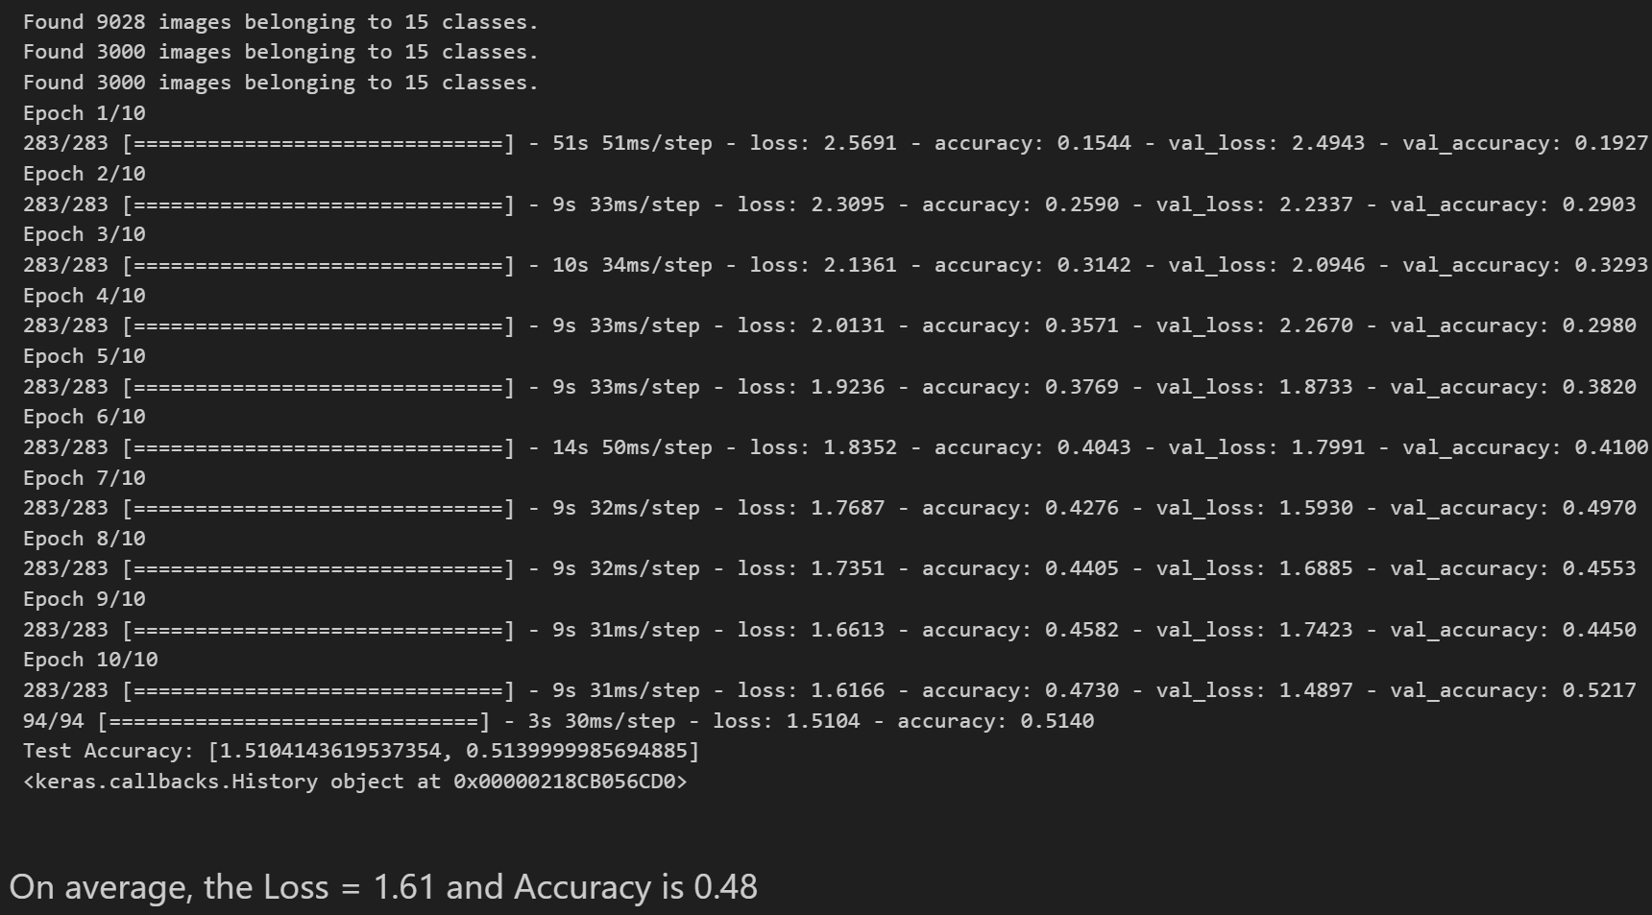
Creating Base Model

Slide 12
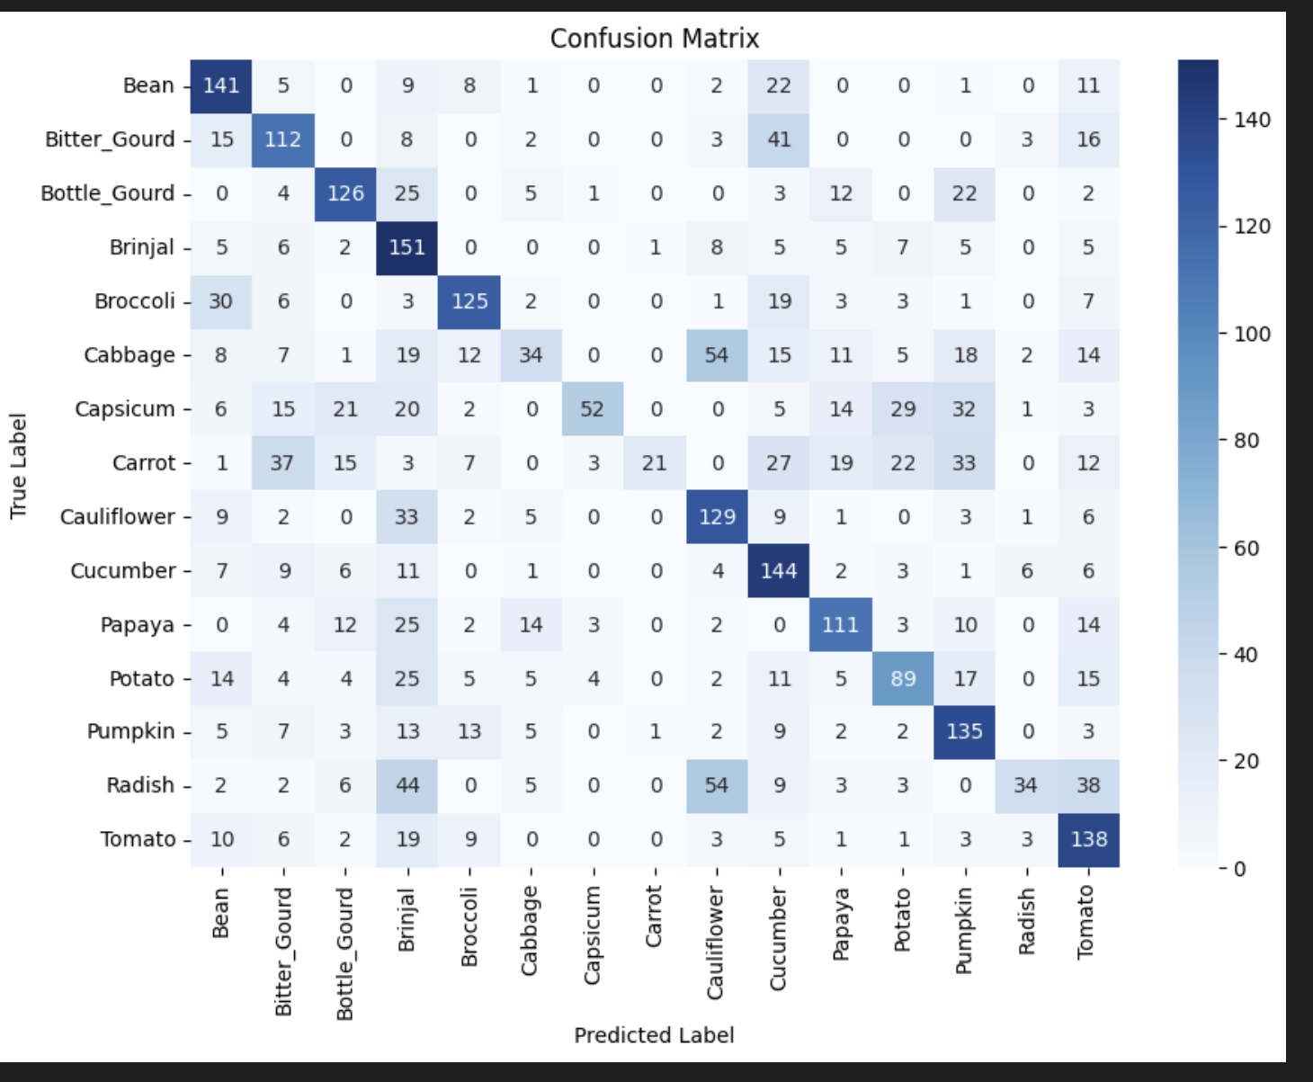
Confusion Matrix for Base Model
Cabbage Capsicum, Carrot and Raddish were the worst predicted among the 15 vegetables

Slide 13
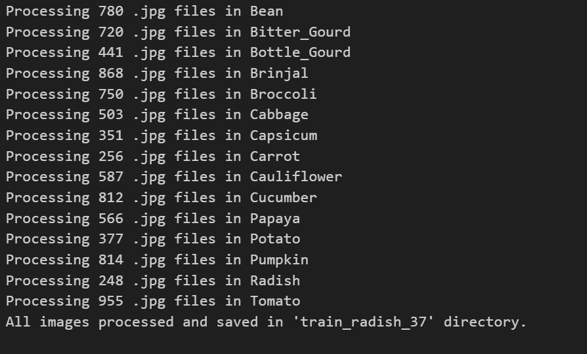
Data Augmentation
I decided to find out if Augmenting the number of Radish Images to be the same as the Tomato(955) since it the highest number, would affect the model

Slide 14
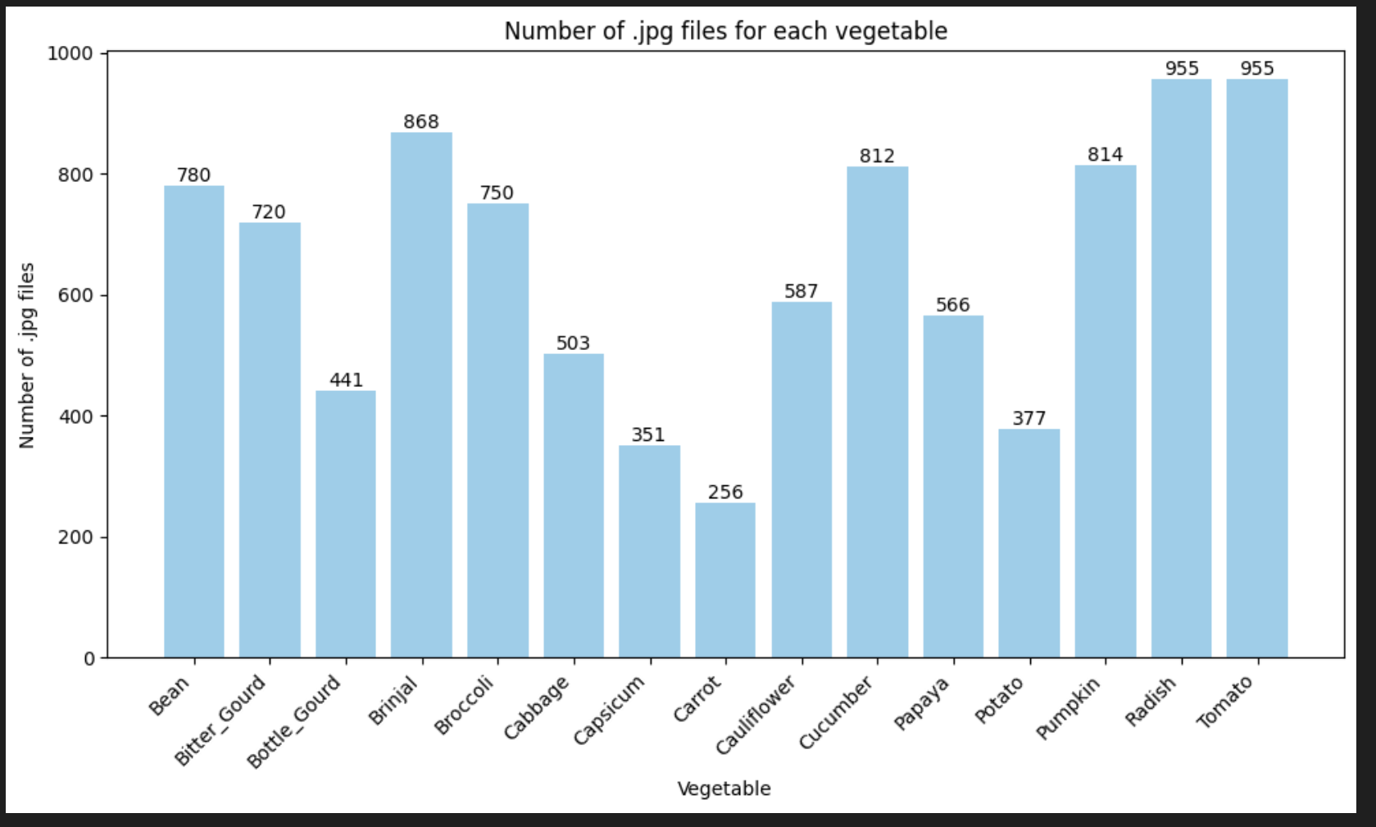
Data Augmentation(Radish)

Slide 15
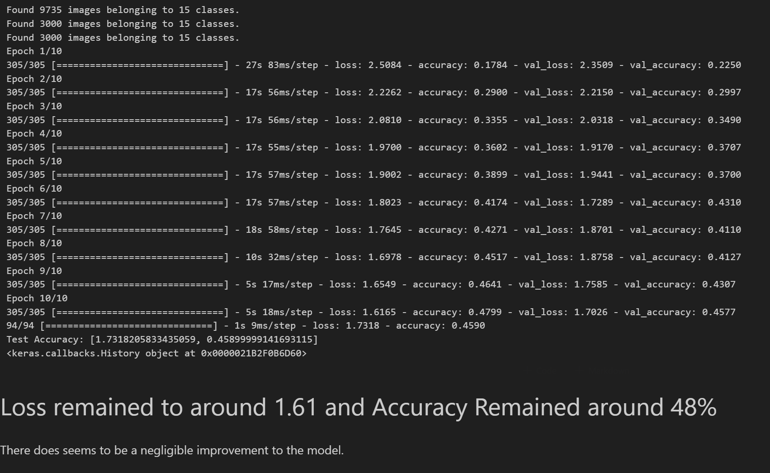
Testing Model After Augmentation

Slide 16
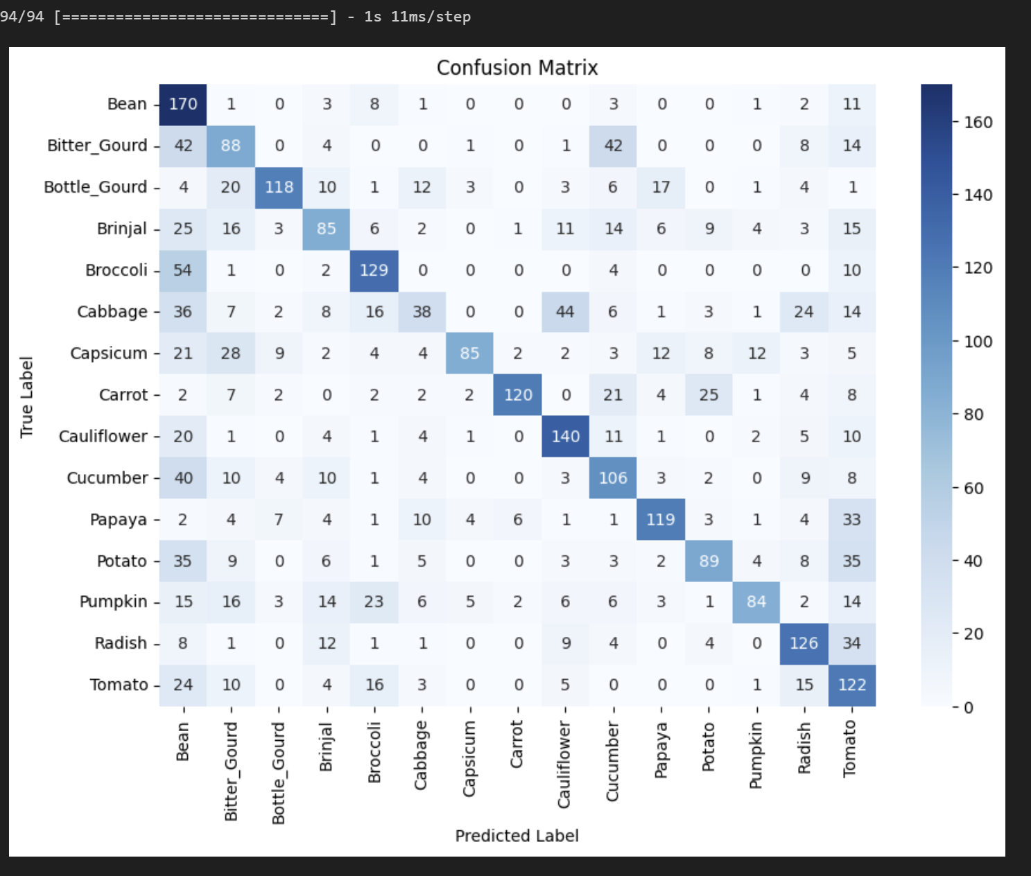
Confusion Matrix(Radish Augmentation)
-Comaparing the Radish correctly predicted values, it actually increased from 34 to 126, there seems to be an improvement by augmentation.
-The beans columns seems to have more wrongly predicted vegetables, which may be caused by the augumentation of the radish images, that may have predicted the wrong vegetables.

Slide 17
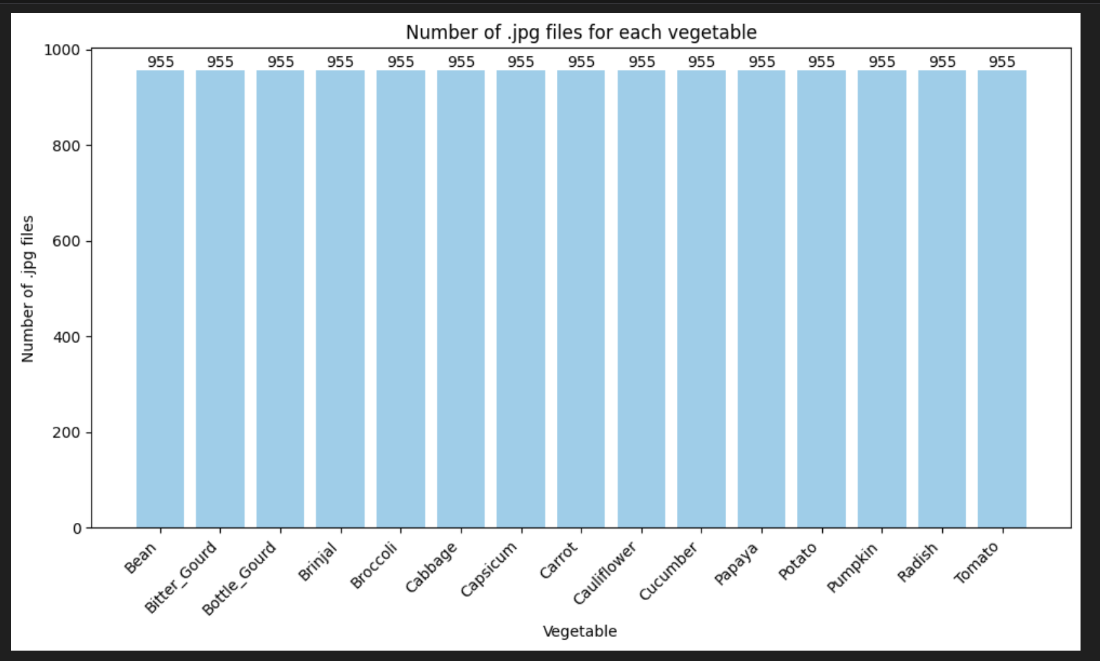
Augmentation(Rest of Vegetables)
I augmented the rest of the vegetables to 955 images, and stored it in train_augmented_37

Slide 18
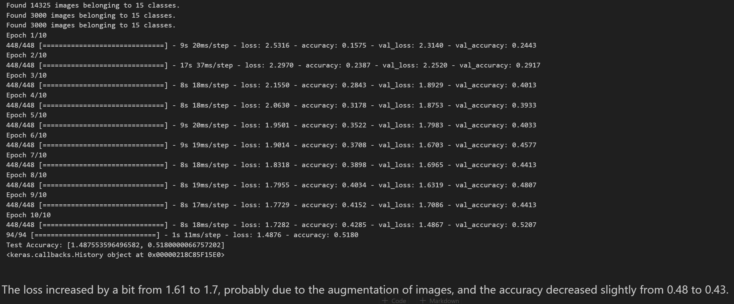
Testing Model (After Augmented IMG)

Slide 19
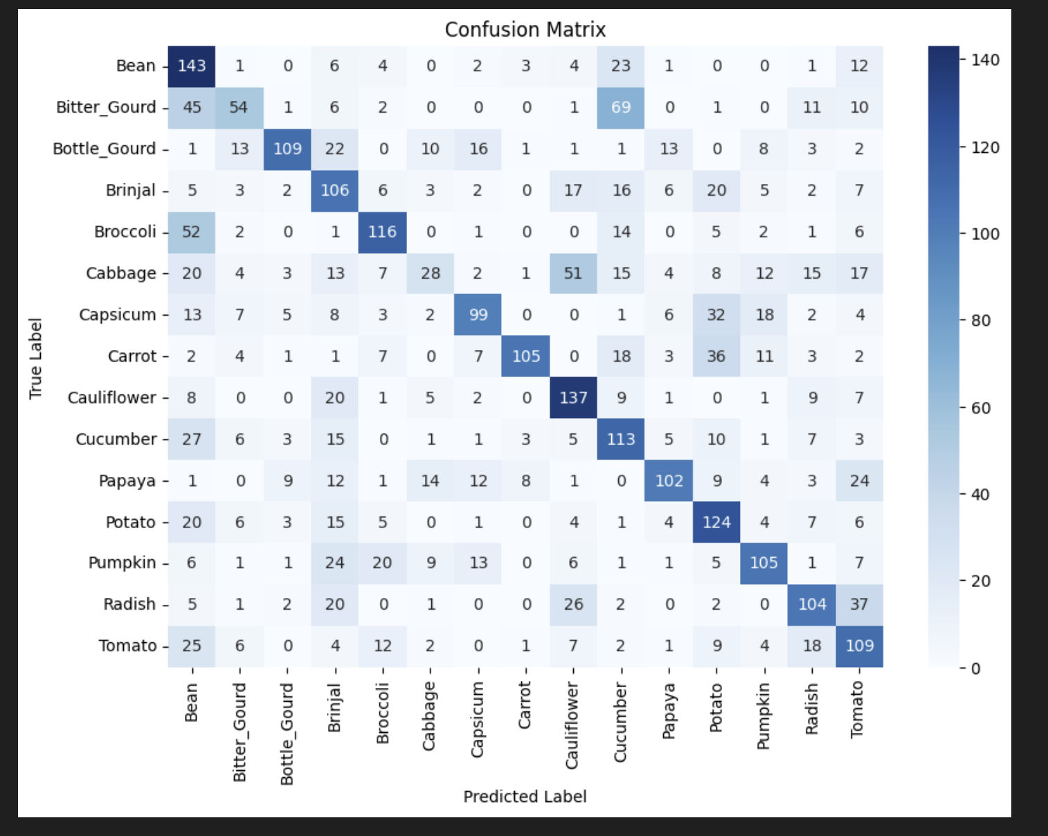
Confusion Matrix(After Augmentation)
Generally, after augmenting the rest of the vegetables, the correctly predicted vegetable for pumpkin(84 to 105), potato(89 to 124) and Brinjal(85-126) had the most significant improvement, and the wrongly predicted bean images were also reduced slightly.
However, it seems like the model wrongly predicted more bitter_gourd as cucumber (42 to 69), likely because the shape is similar. Also with Cauliflower and cabbage (44 to 51)

Slide 20
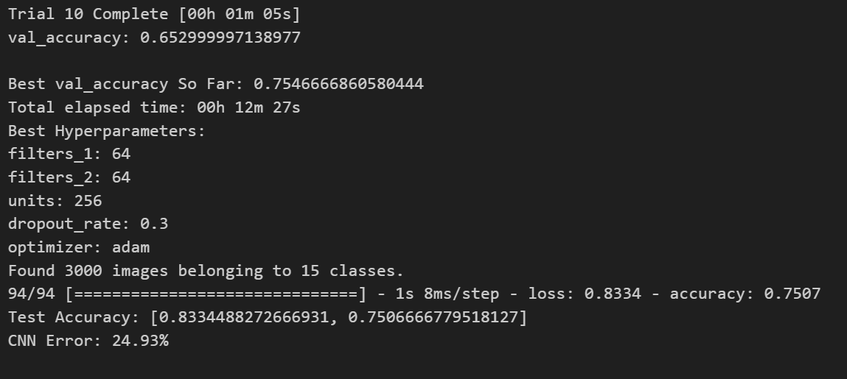
Hyperparameter Tuning/Model Improvement
I decided to use GridSearch to find the best hyperparameters and fit the model again.

Slide 21
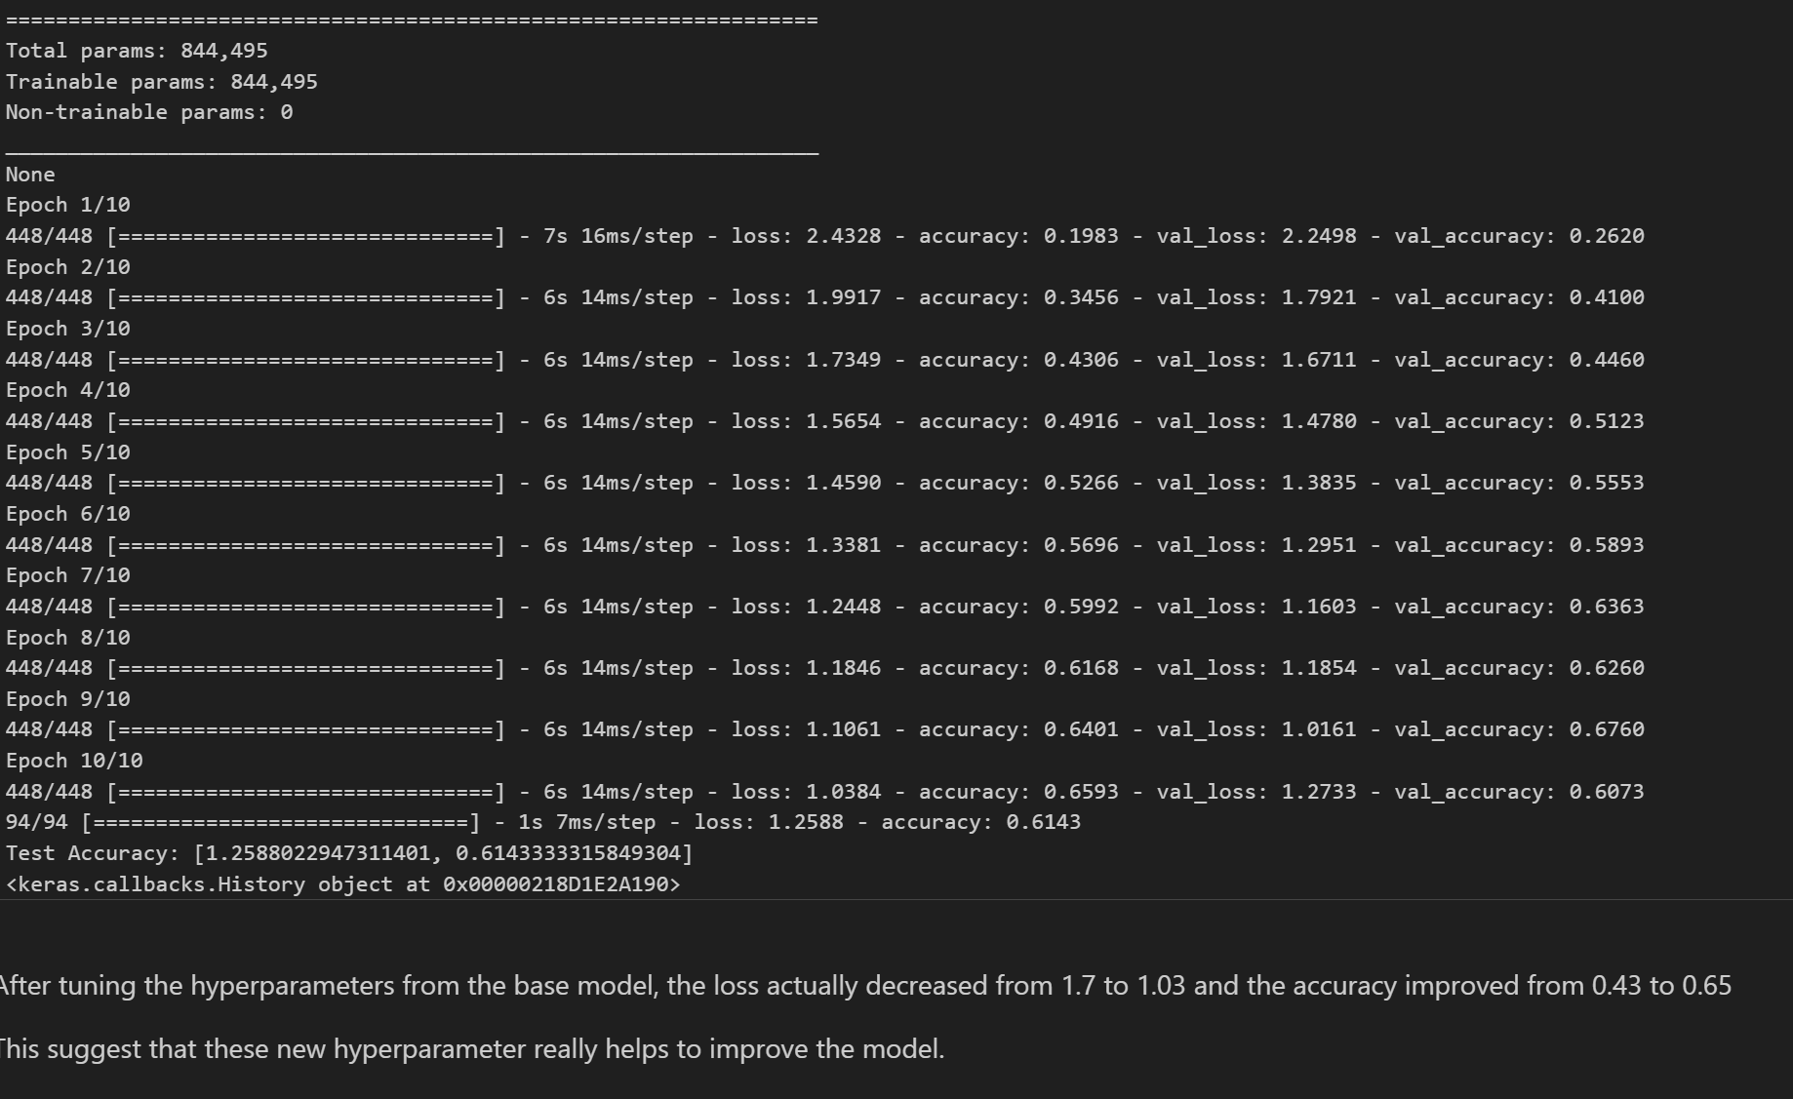
Fitting Model with best hyperparameters

Slide 22
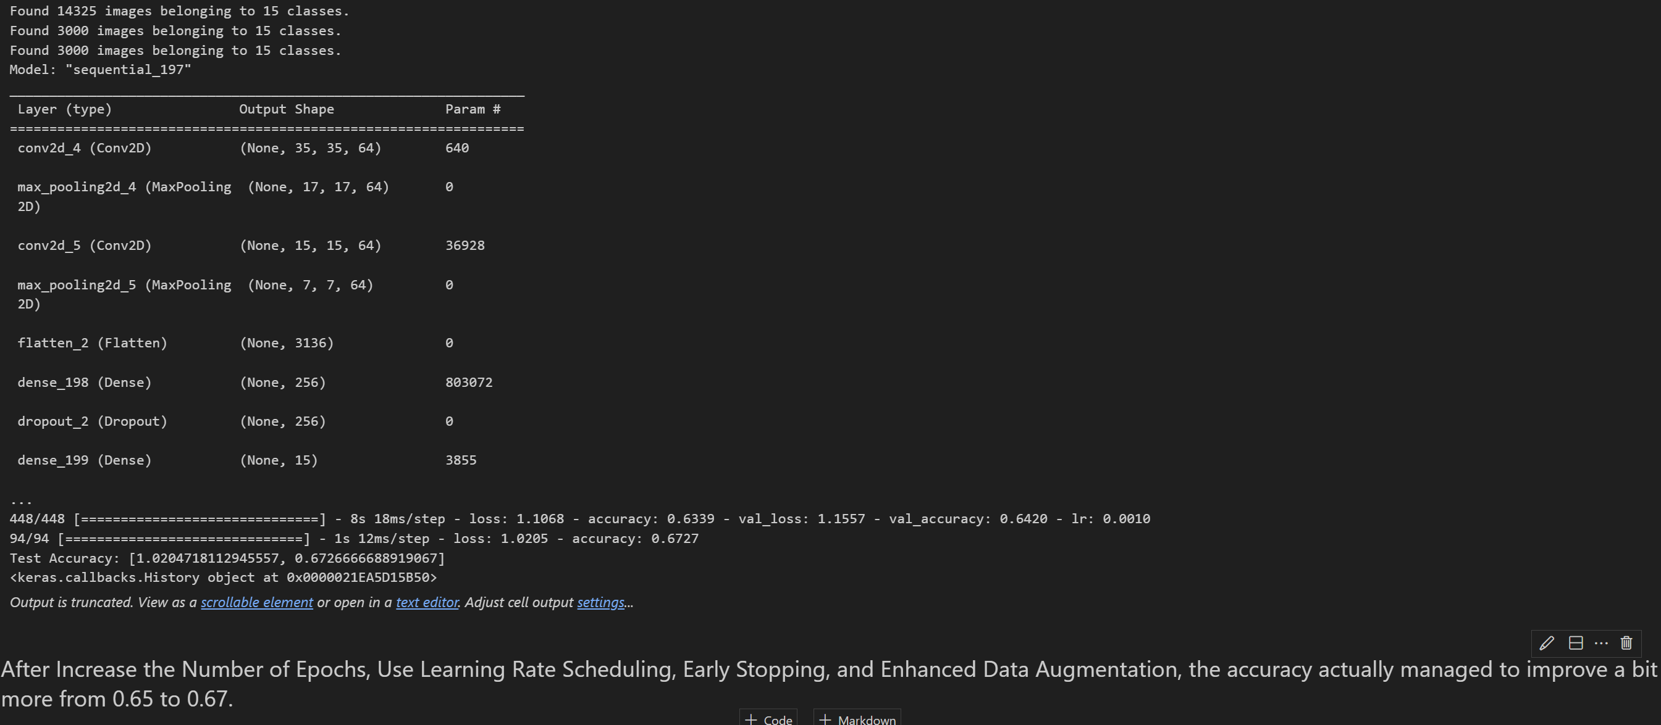
Further Improvement

Slide 23
For 131x 131 and grayscale images
For the other CNN Model, I followed similar steps. Only difference is using 131x131 instead of 37x37 and the images dimension.

Slide 24
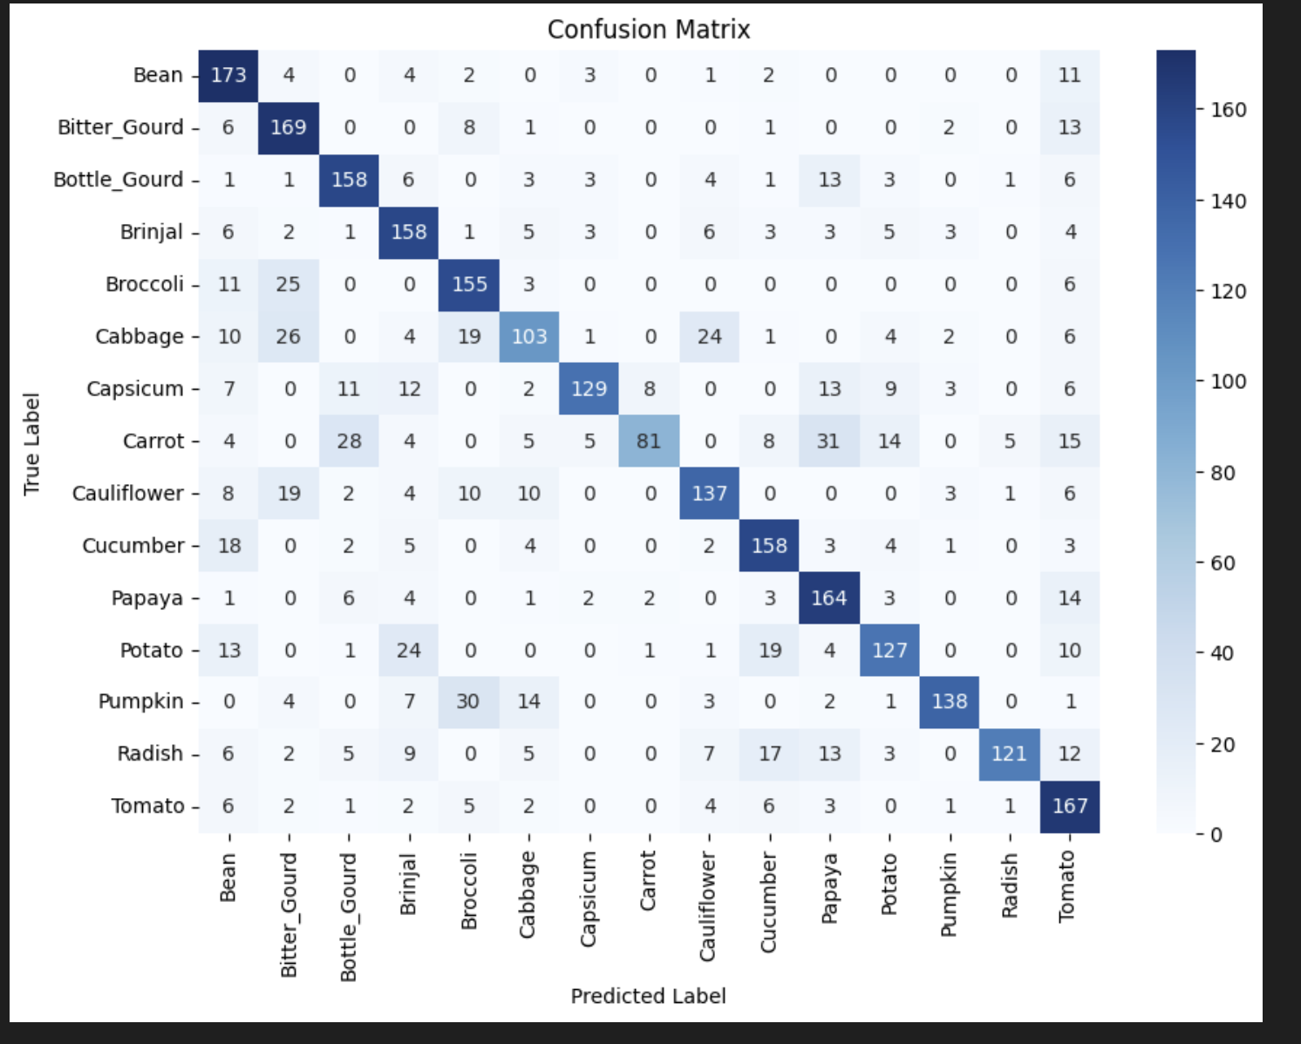
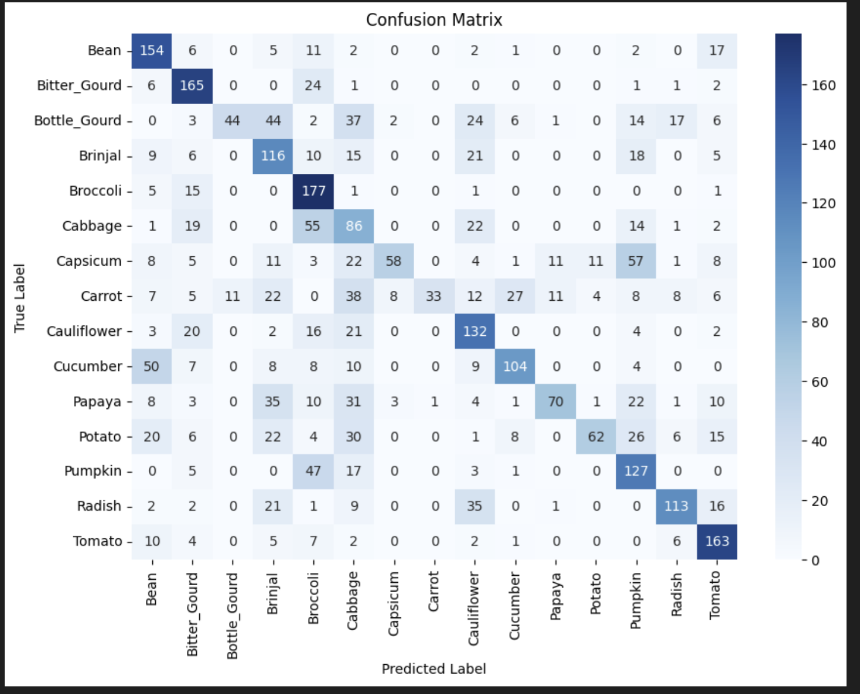
Confusion Matrix(Base and Radish)

Slide 25
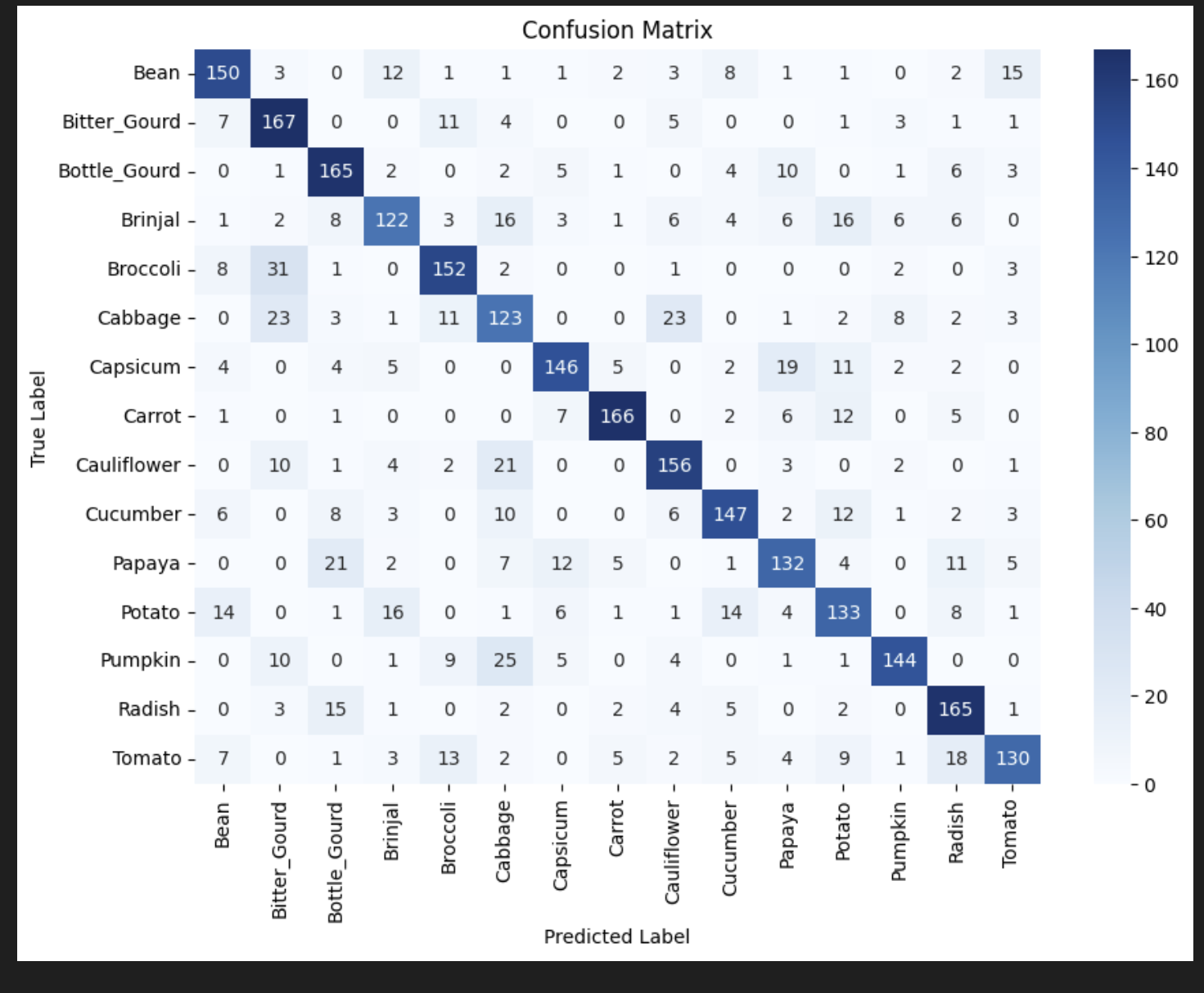
Confusion Matrix(After Augmenting)

Slide 26
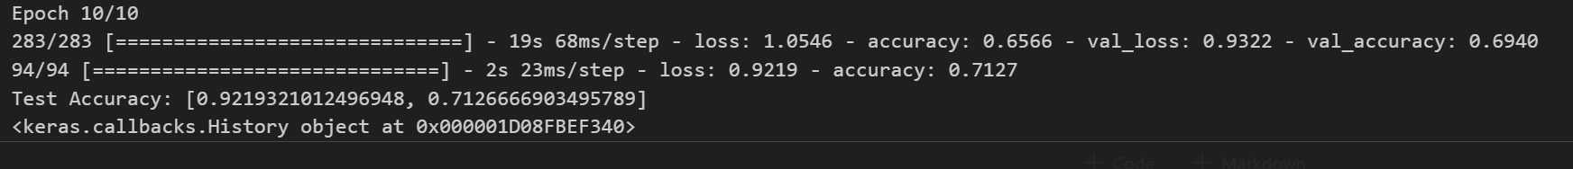
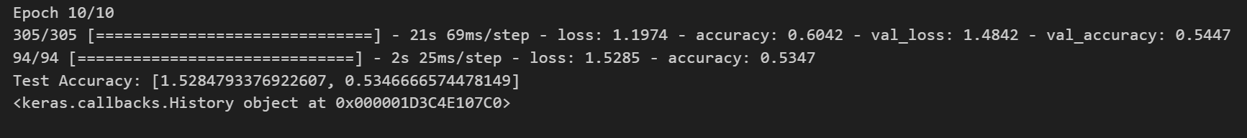
Accuracies(131x 131)

Slide 27
PART B: RECURRENT NEURAL NETWORK
Background research and exploratory data analysis
Feature engineering
Modelling and evaluation
Model improvement

Slide 28
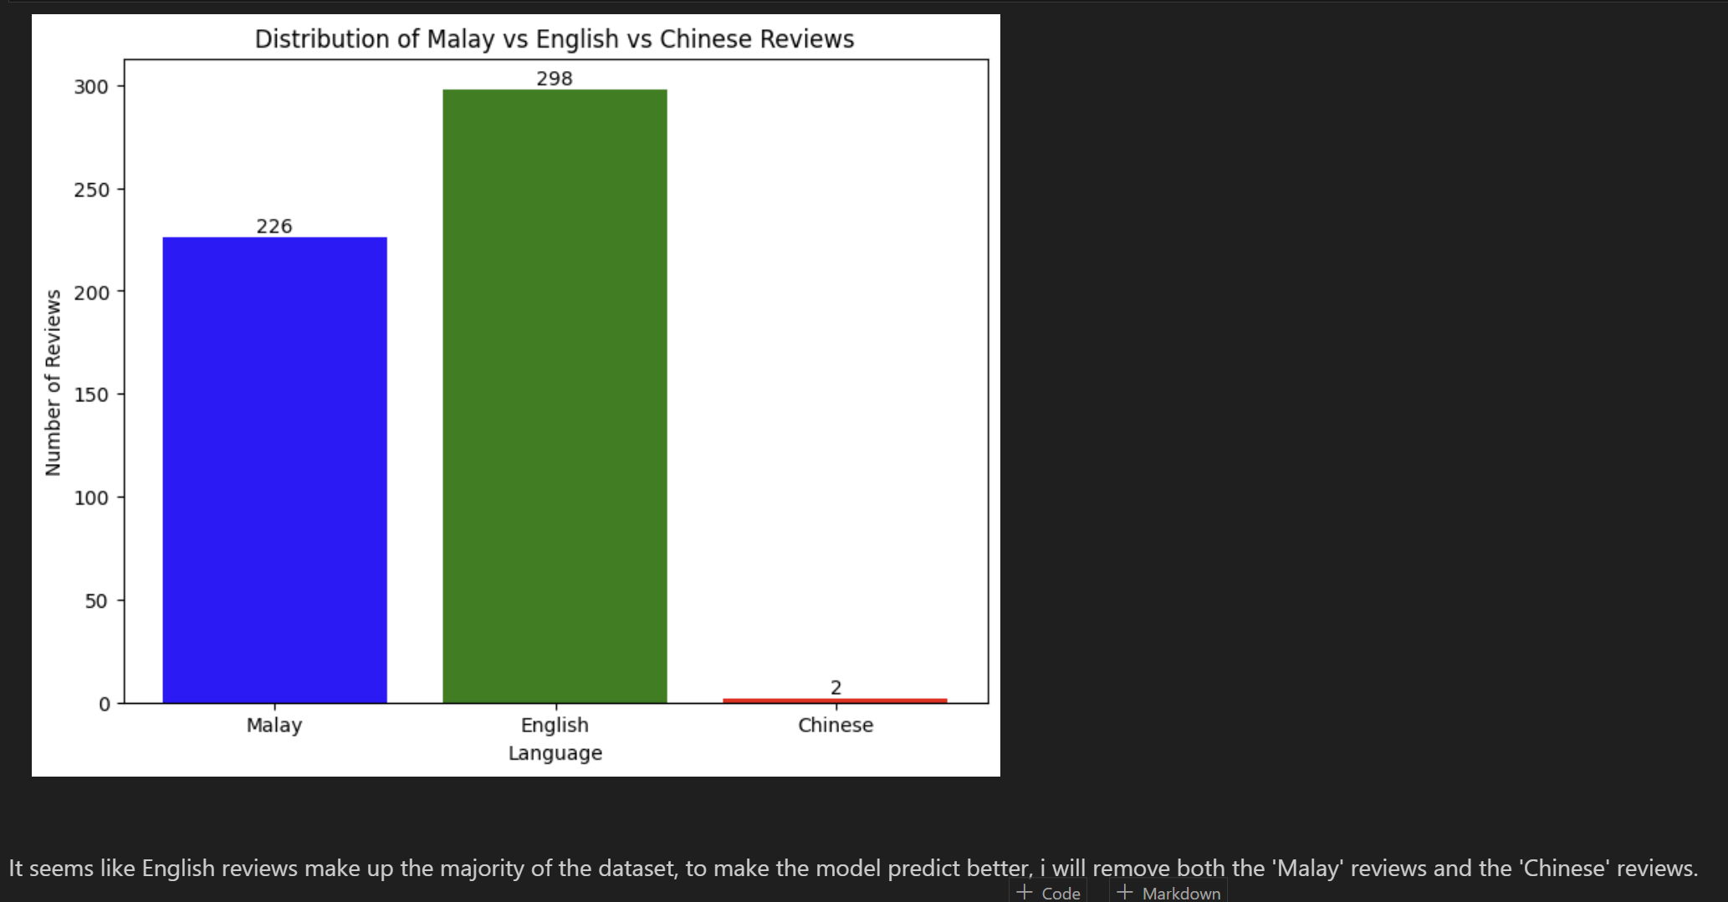
Exploratory Data Analysis

Slide 29
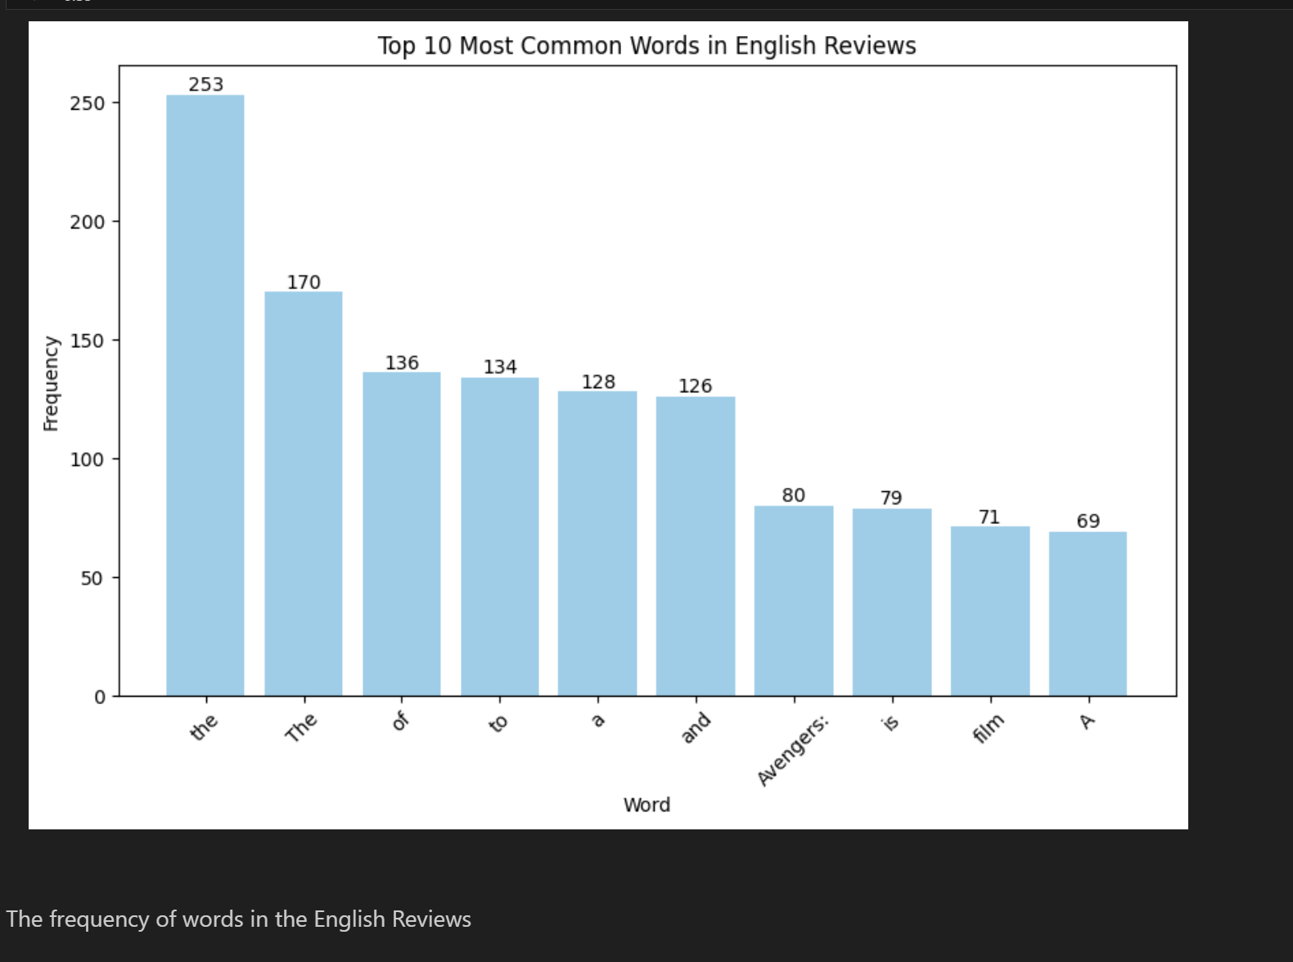
EDA(Continued)

Slide 30
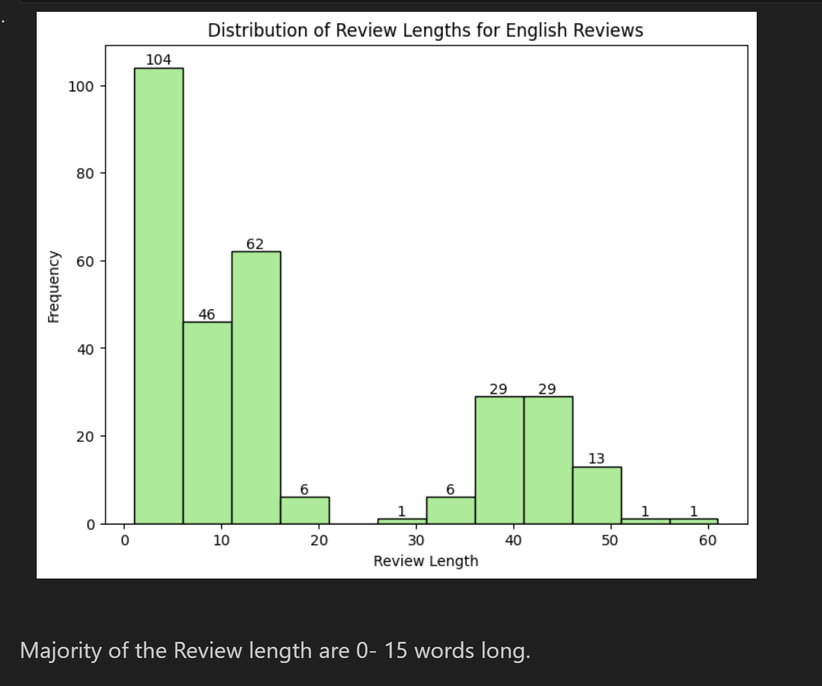
EDA (Continued)

Slide 31
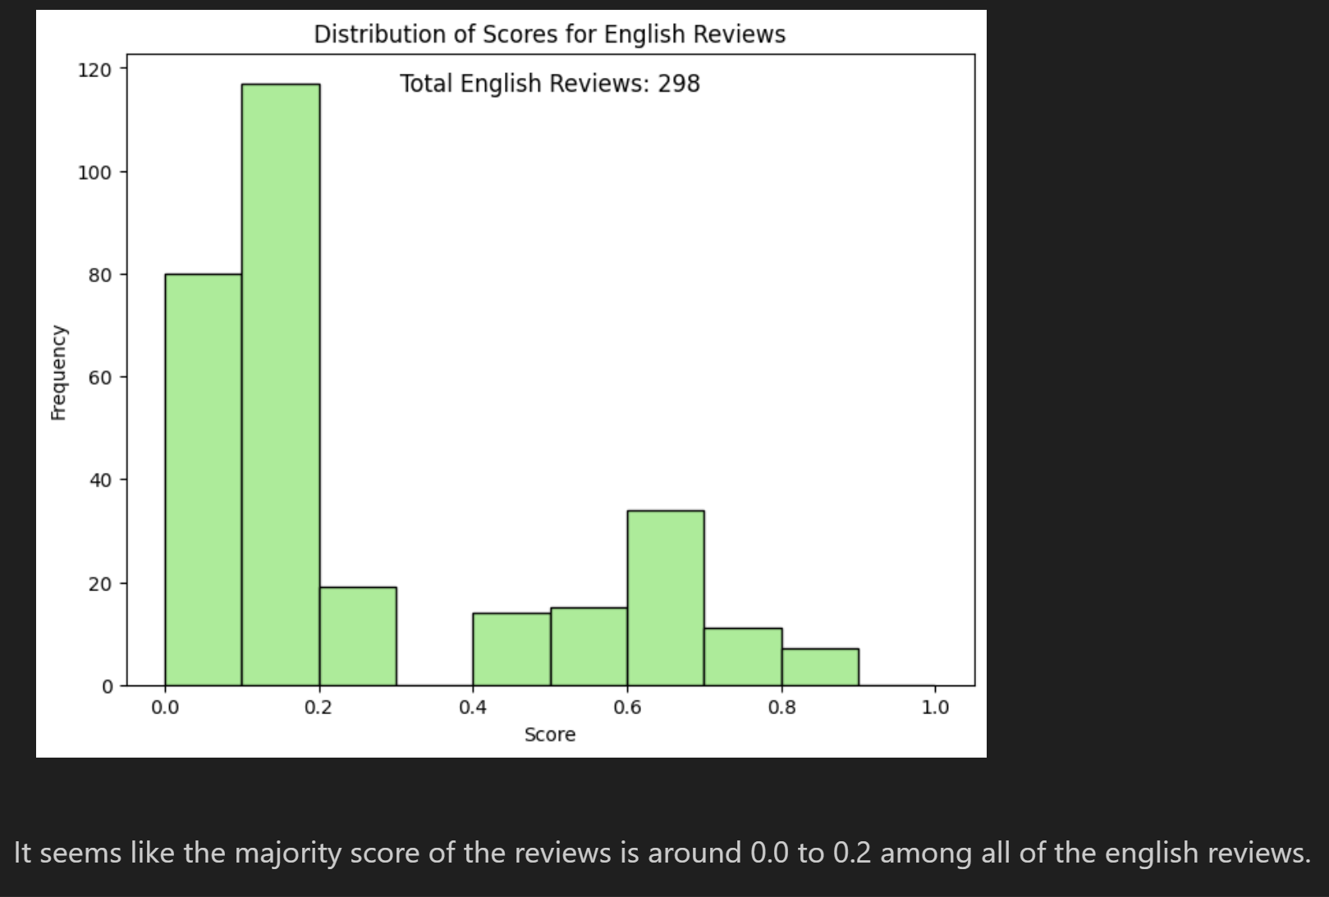
EDA(Continued)

Slide 32
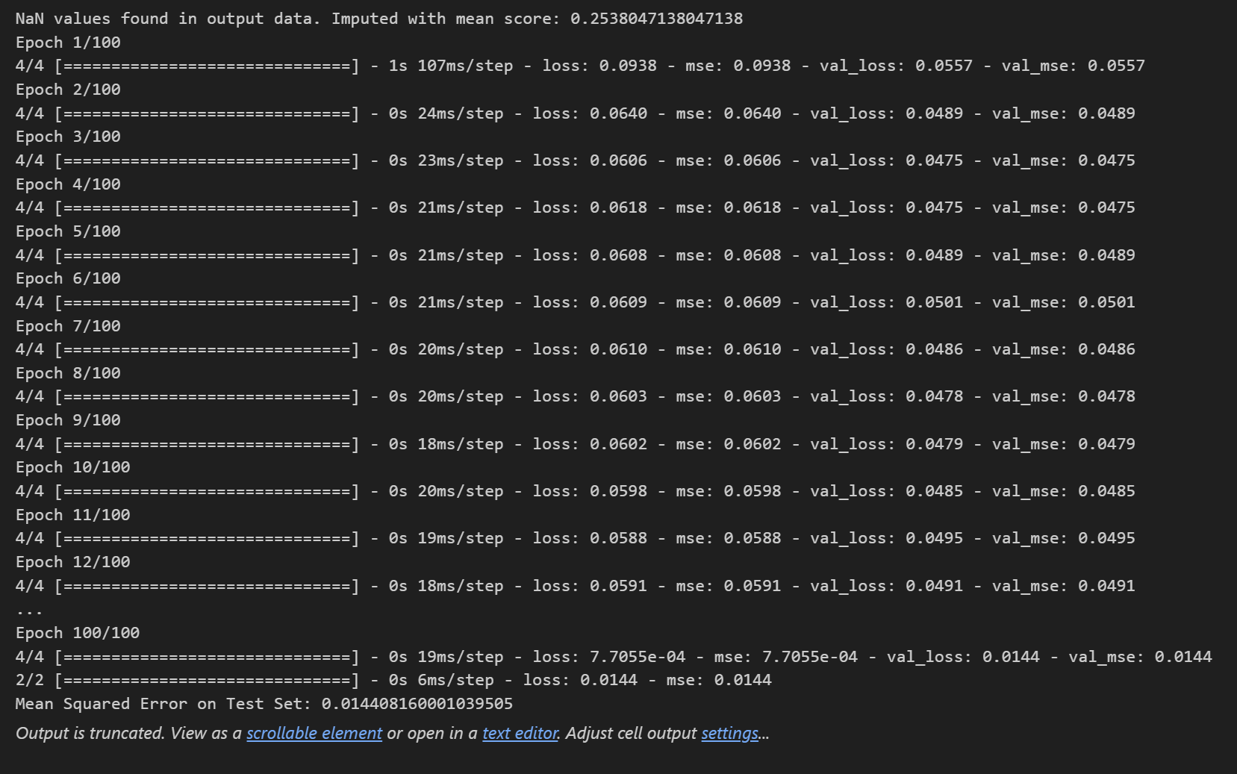
Training and Testing RNN Model
Base Model Accuracy(Only predicting English Review Scores)

Slide 33
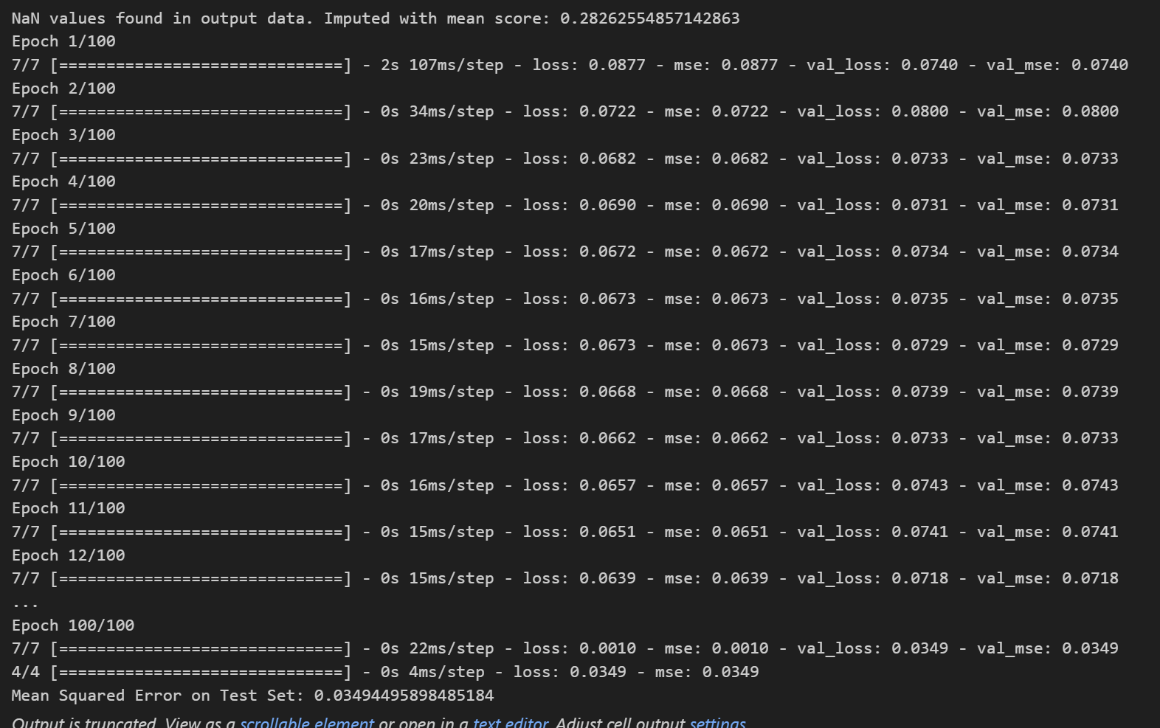
Training and Testing RNN Model
Base Model Accuracy(Predicting all languages review(Malay, Chinese, English))

Slide 34
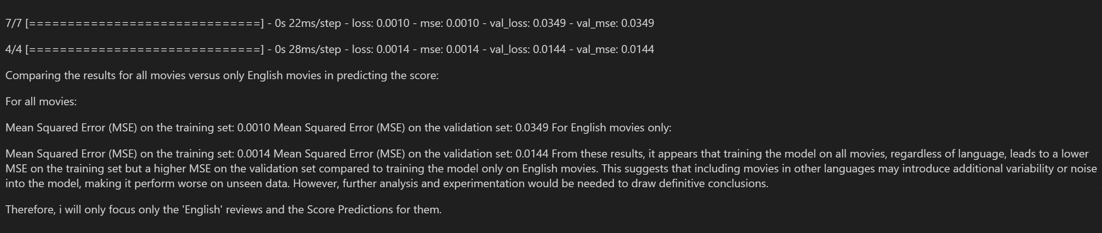
EDA(Continued)

Slide 35
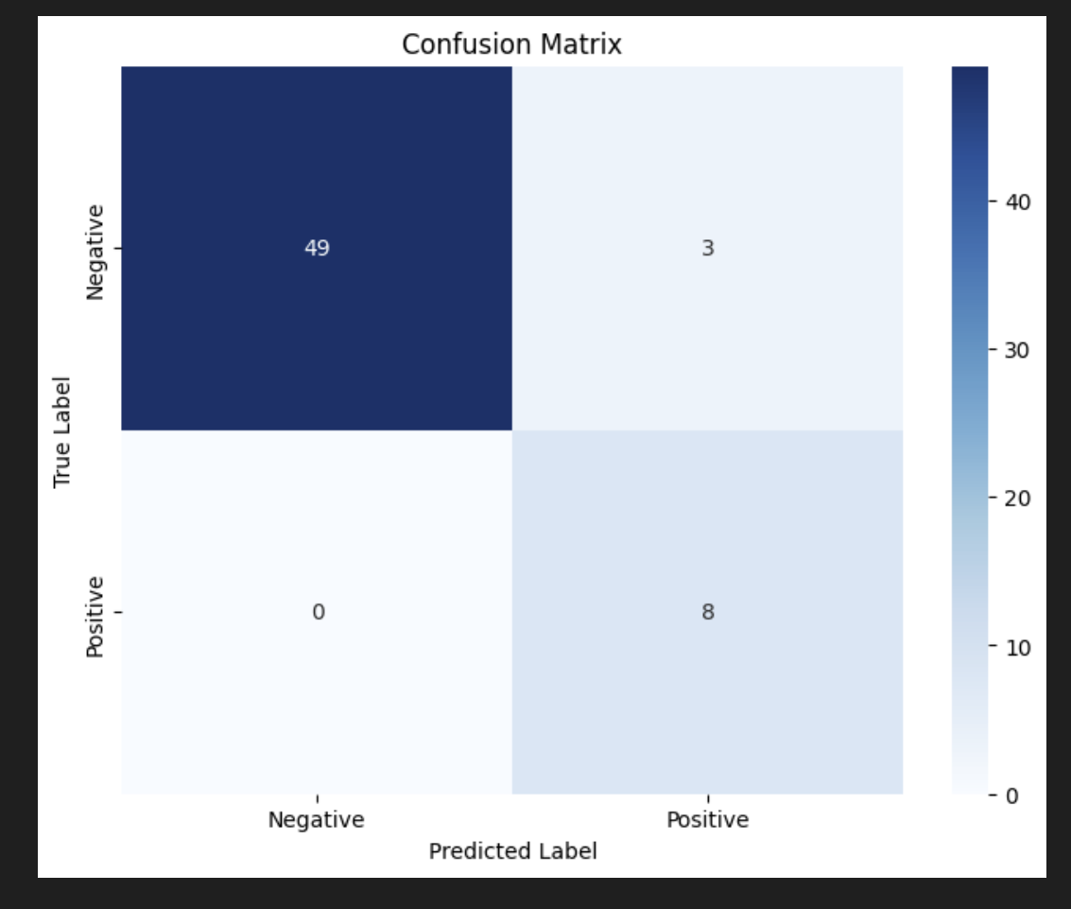
Confusion Matric(Base RNN Model)
RNN Model seems to predict more Negative Reviews than Positive Reviews based on the Confusion Matrix.

Slide 36
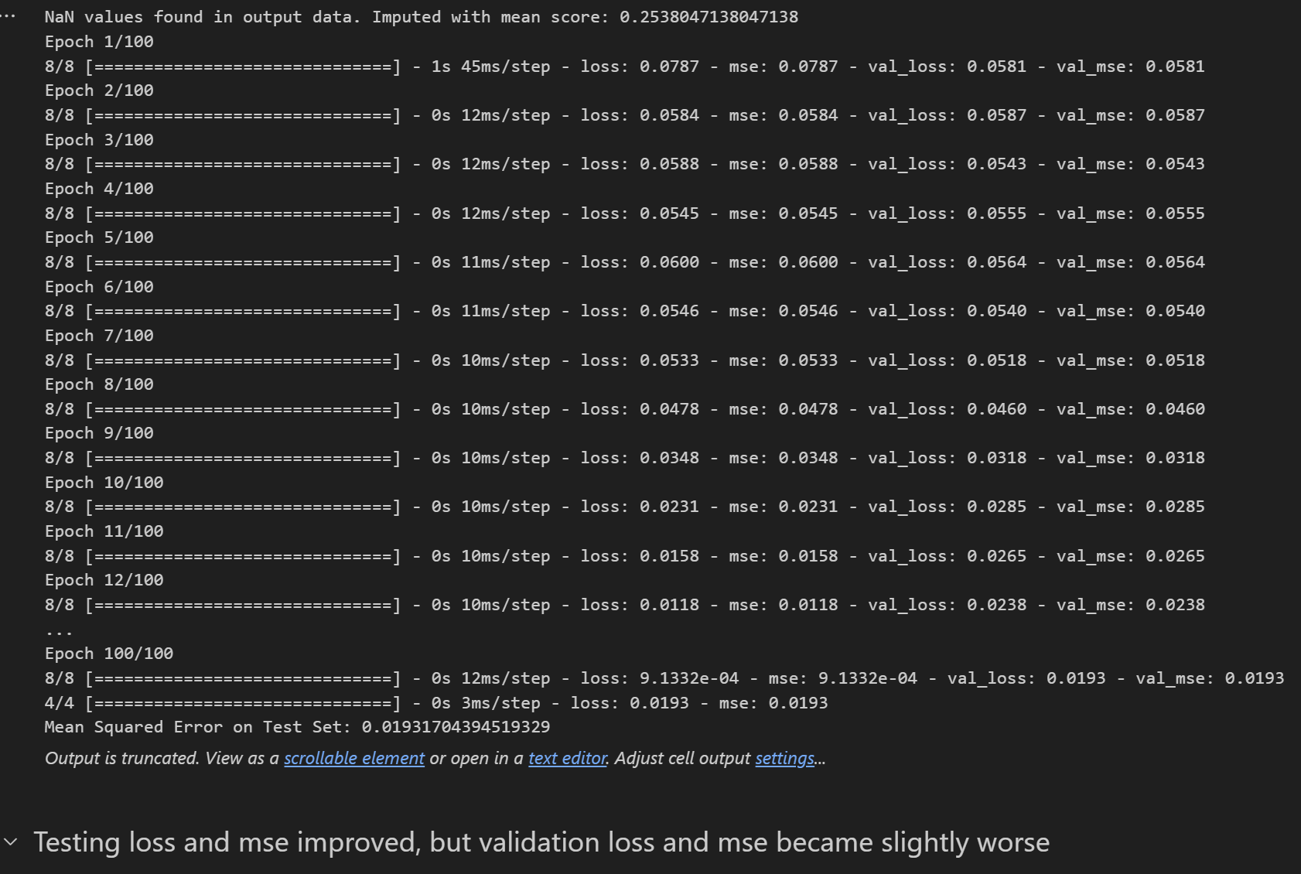
Imputing More Data

Slide 37
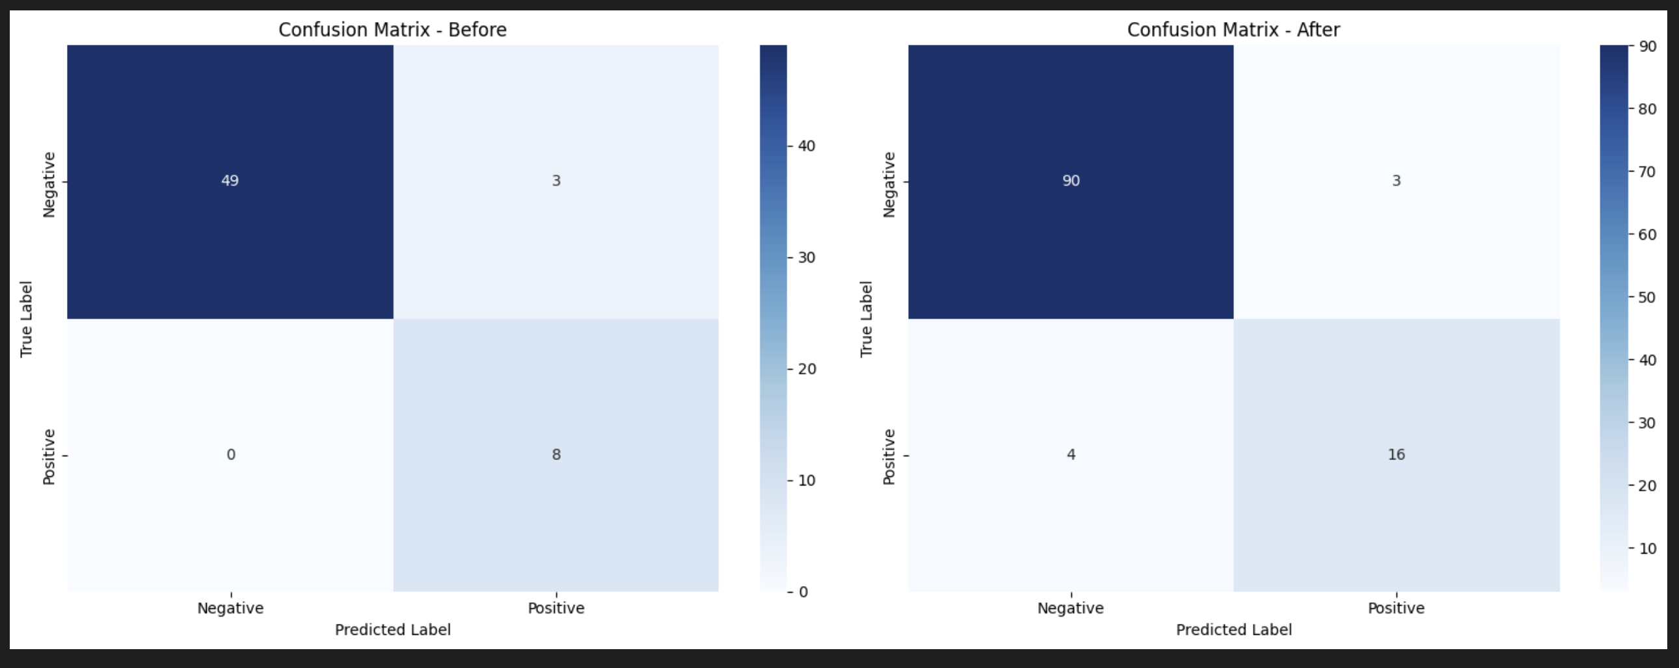
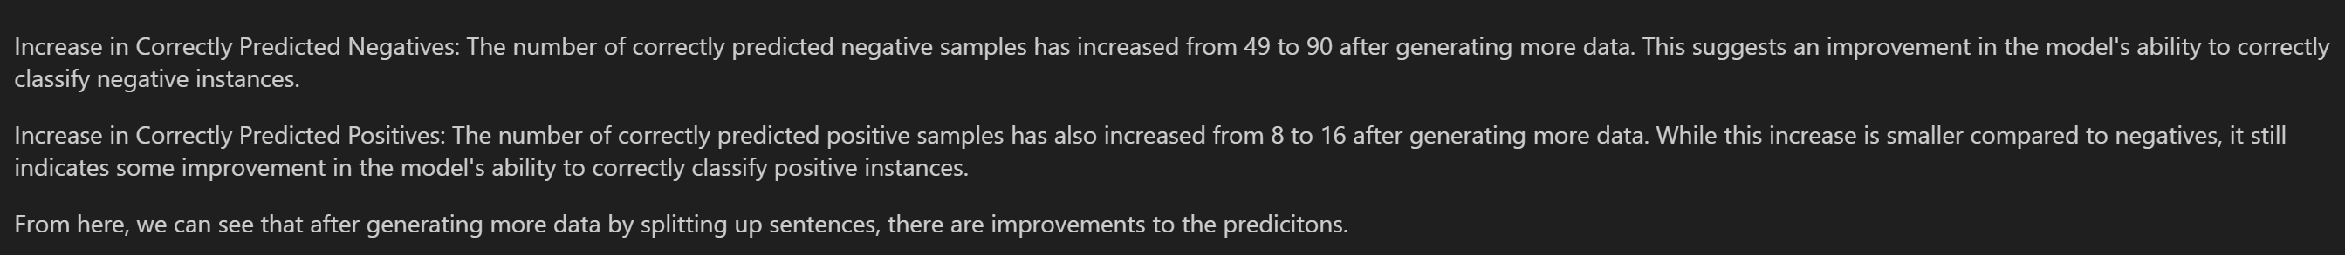
Comparing Confusion Matrix

Slide 38
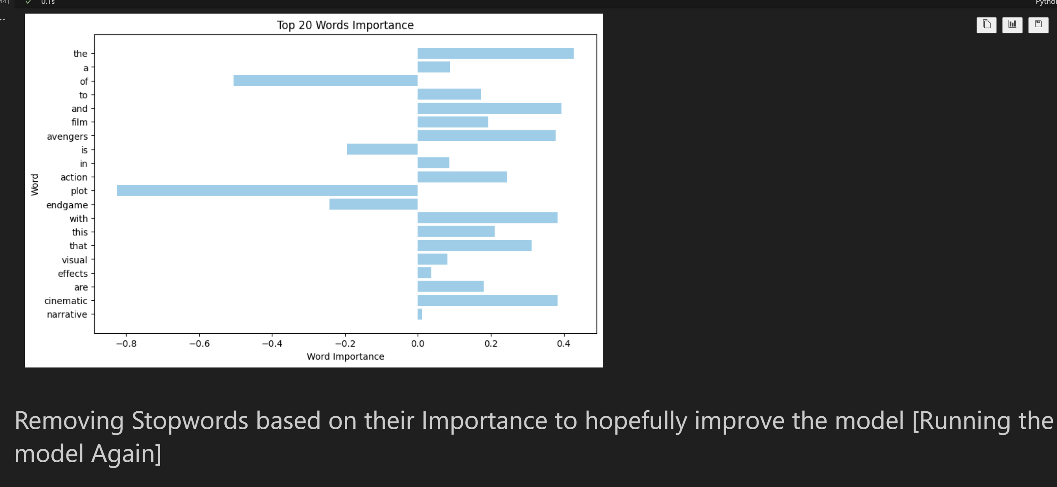
Visualizing Importance of Words

Slide 39
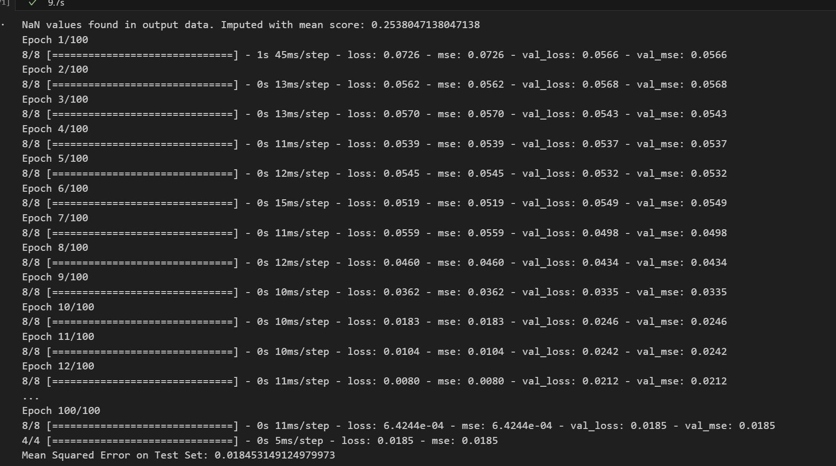
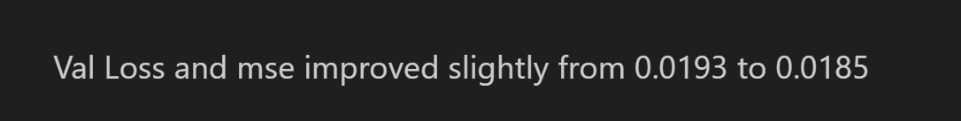
Test and Train Model Again

Slide 40
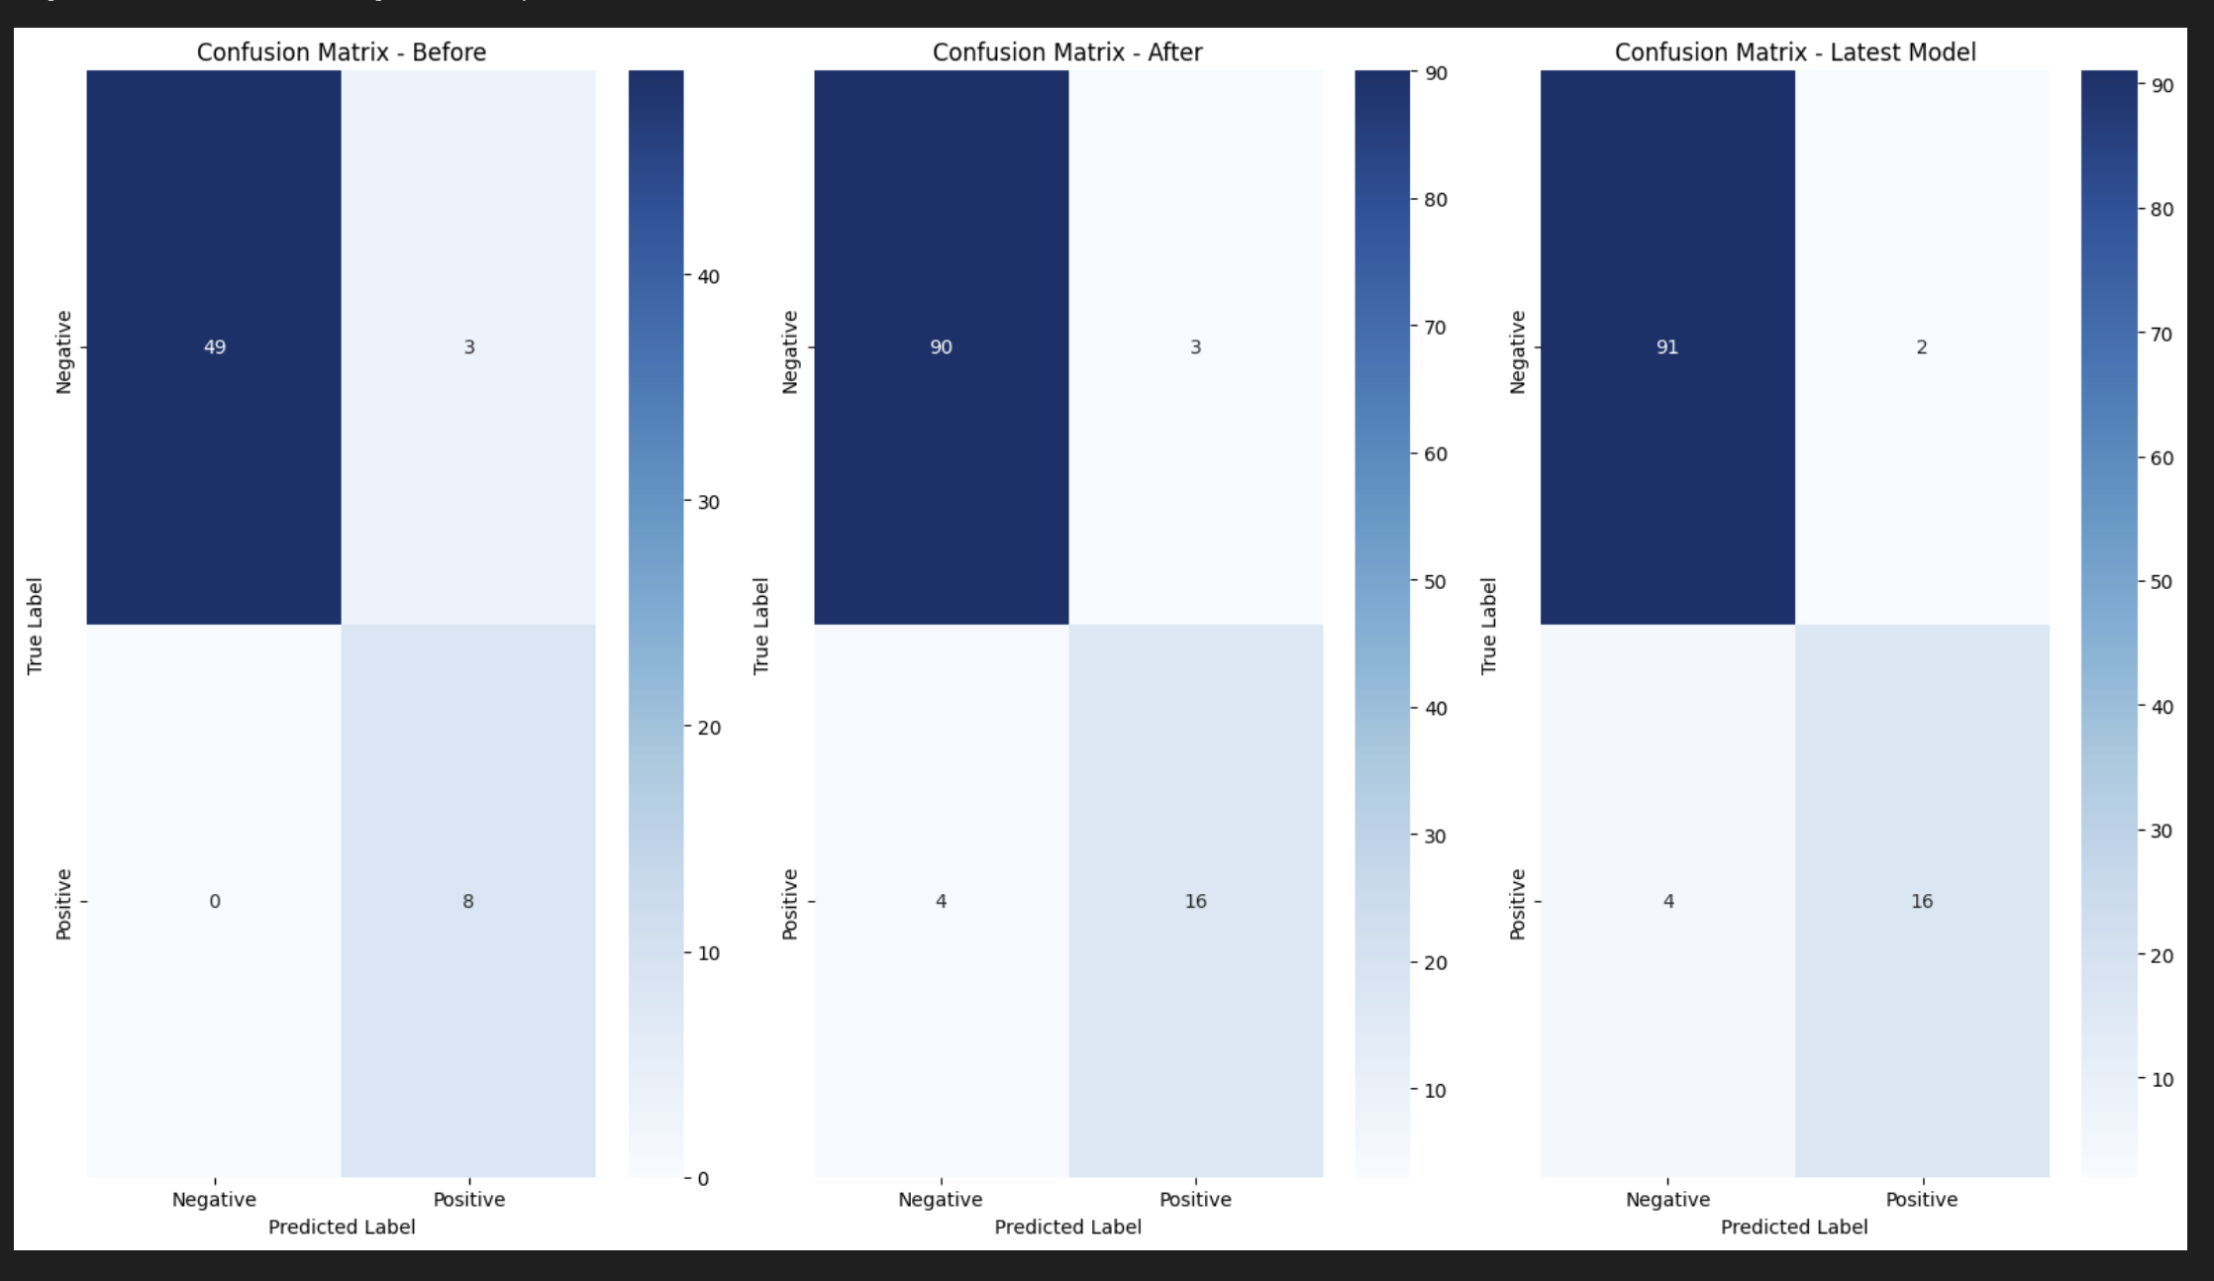

Confusion Matrix(ALL THREE)

Slide 41
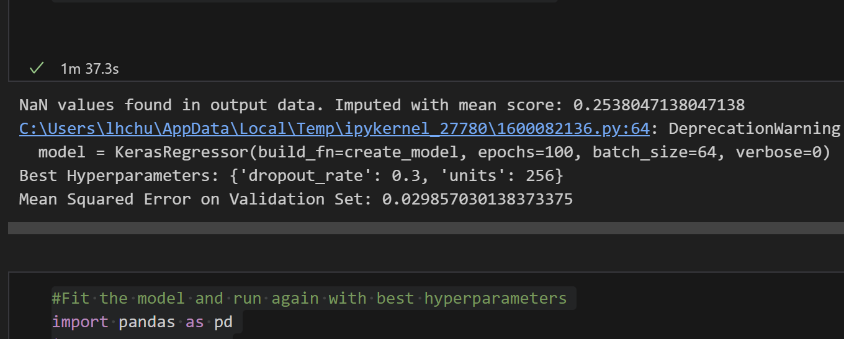
Hyperparameter Tuning
I used GridSearch to find the best hyperparameters

Slide 42
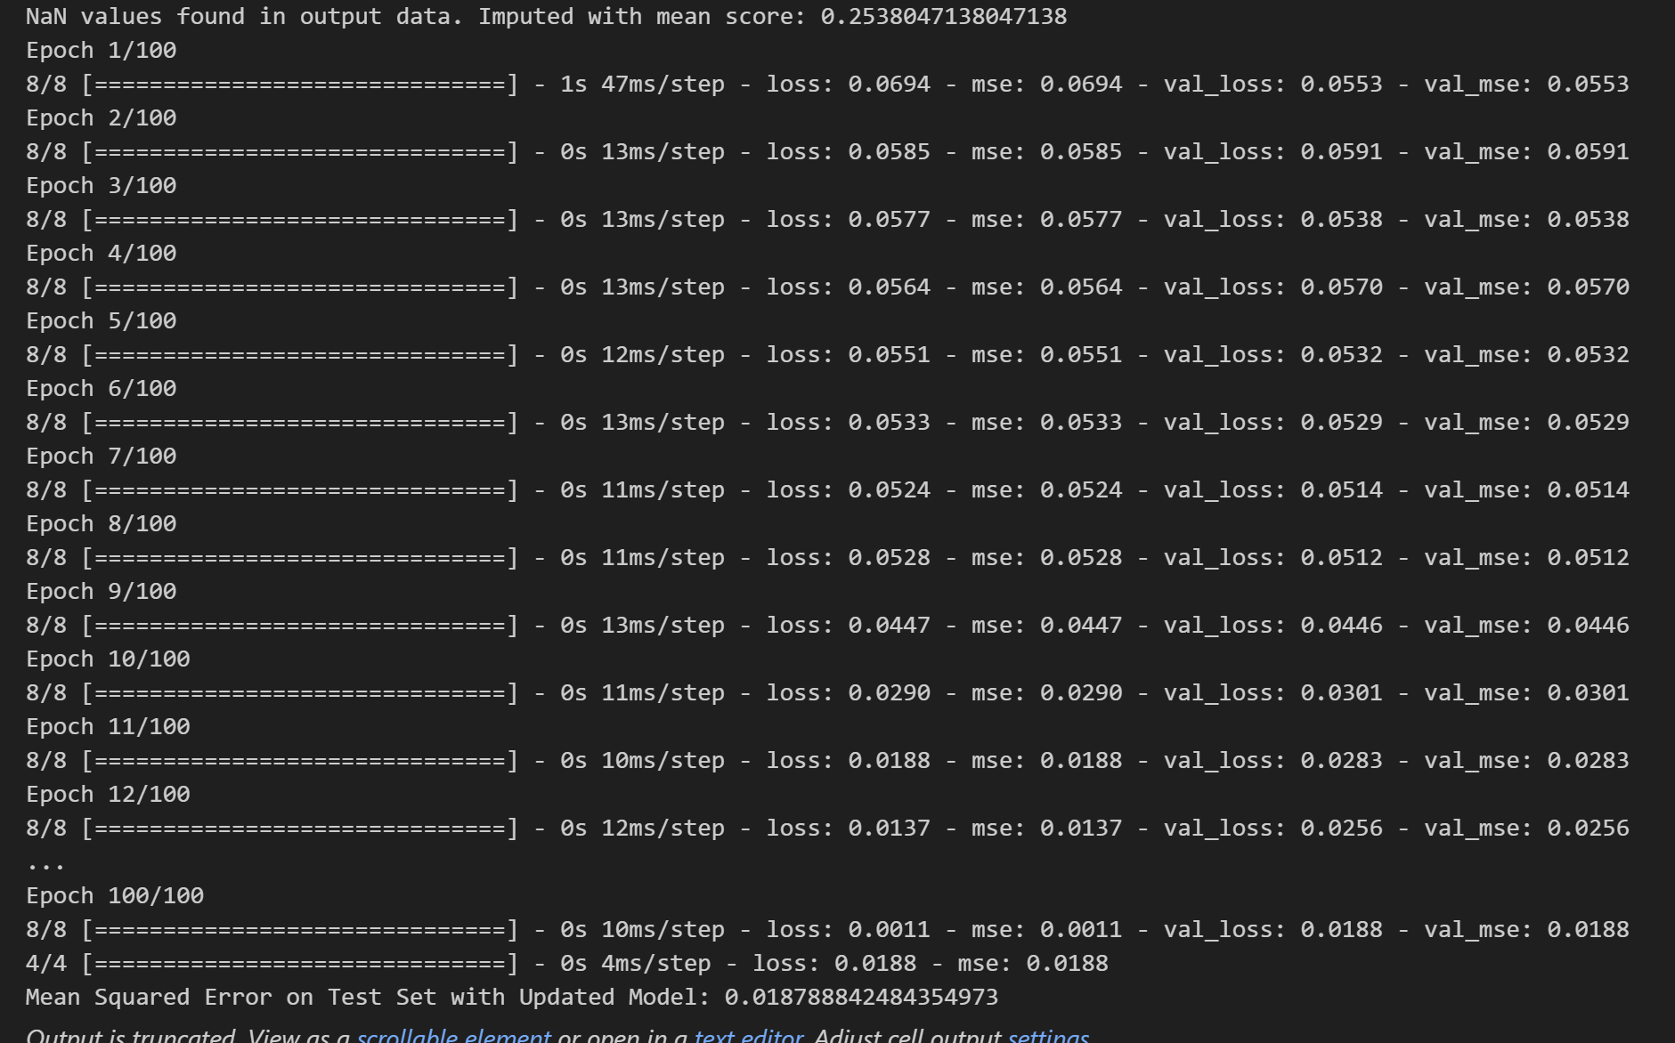
Fit the Model Again with best hyperparametes

Slide 43
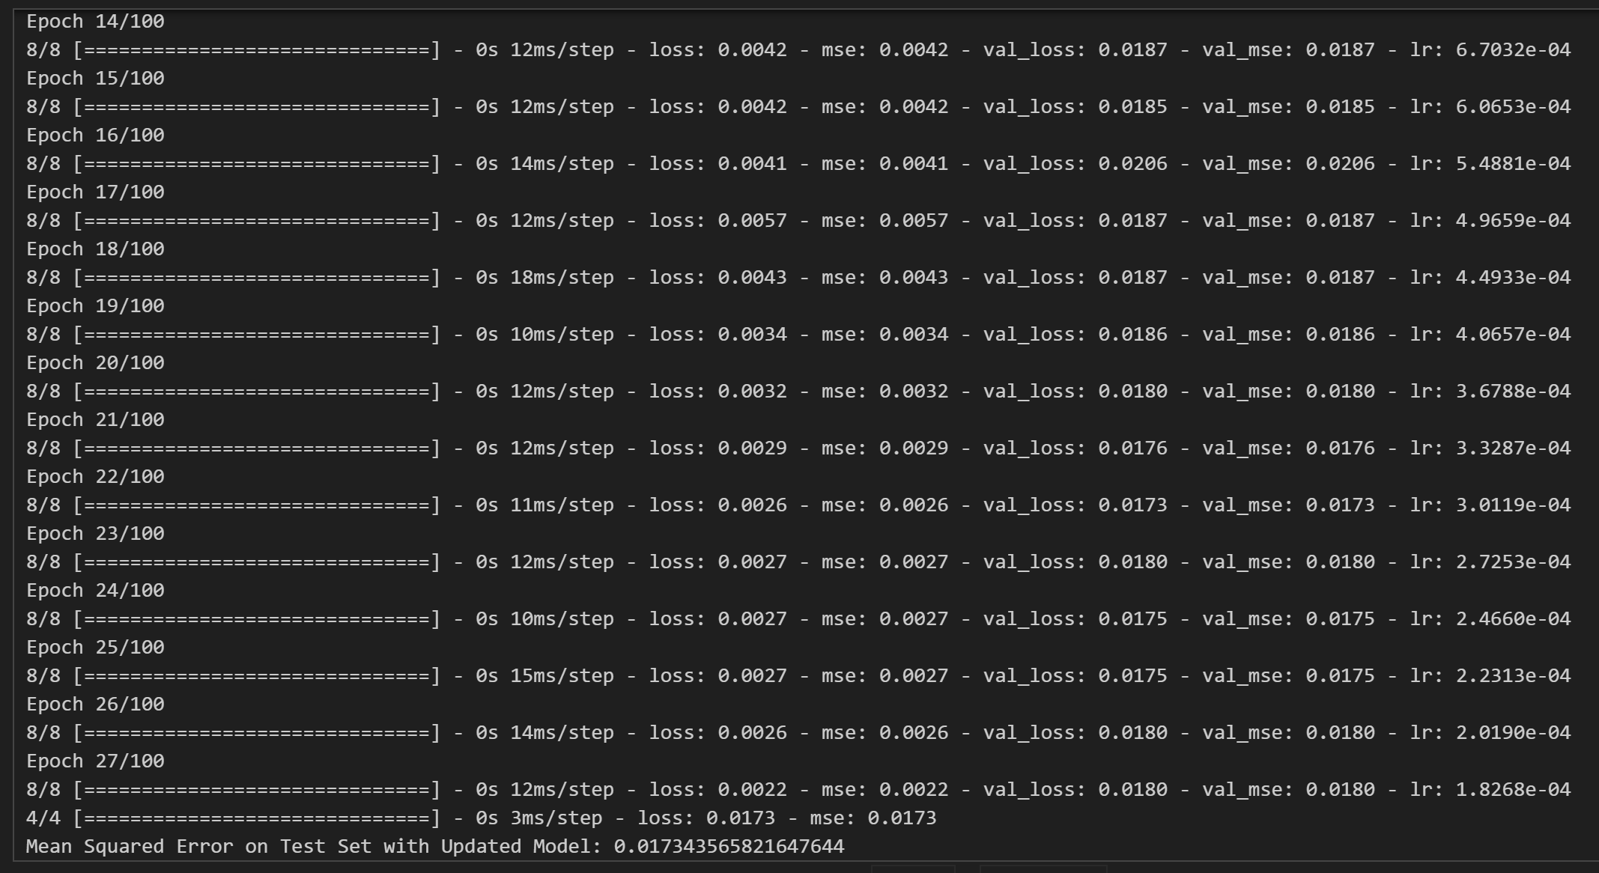
Improving model further
Improving Model with Learning Rate Callback and Early Stopping Callback
Validation mse and loss improved from 0.0188 to 0.0180
Testing loss and mse is also very close to zero

